Slide 1
Journal Entries & ID Charges

Slide 2
Agenda
In this session we will look at:
What is a Journal Voucher
When to use a Journal Entry and an Interdepartmental Charge
Security Rules
Journal Voucher Pages

Slide 3
Session Objectives
At the end of this training session, you will be able to:
Create a Journal Entry
Create an Interdepartmental Charge
Copy and Reverse a Journal Voucher
View In Progress Journal Vouchers

Slide 4
Journal Vouchers
What is a Journal Voucher?
A procedure for transferring revenue/expenditures between FOAP(AL) elements
Journal Vouchers are used for:
Journal Entries – Corrections/adjustments to FOAP(AL) elements
Interdepartmental Charges – Sale of goods or services from one department to another

Slide 5
FOAP(AL) Elements
What FOAP(AL) elements are required?
Fund | Identifies source of funds E.g. 1xxxxx for operating, 3xxxxx for research grants
Organization | Identifies faculty or department
Account | What money as spent on or generated revenue E.g. 7xxx for expenses,5xxx for revenue
Program | Classifies Revenue or Expense E.g. 0000 for Rev, 1xxx for operating or 2xxx for grants
Optional
Activity | Used to define unique activities. E.g. Campus Beautification Day, Emergency Preparedness
Location | Primarily used but not limited to Fixed Assets

Slide 6
Journal Entry
When do I use a Journal Entry?
Journal entries should be done whenever a correction/adjustment is required on your FOAP(AL)
An expenditure was coded to the wrong Account
Revenue/expenditure coded to incorrect Fund
Each record requires a journal type
A rule class for the accounting entry

Slide 7
Journal Entry Rule Codes
Used for intrafund transactions
when processing transfers within the same fund
DR 110000-333100-706001-1100
CR 110000-333100-706003-1100
Used for interfund transactions
when processing transfers between funds
DR 110000-333100-706001-1100
CR 121996-333100-706003-1100
JE15
JE16

Slide 8
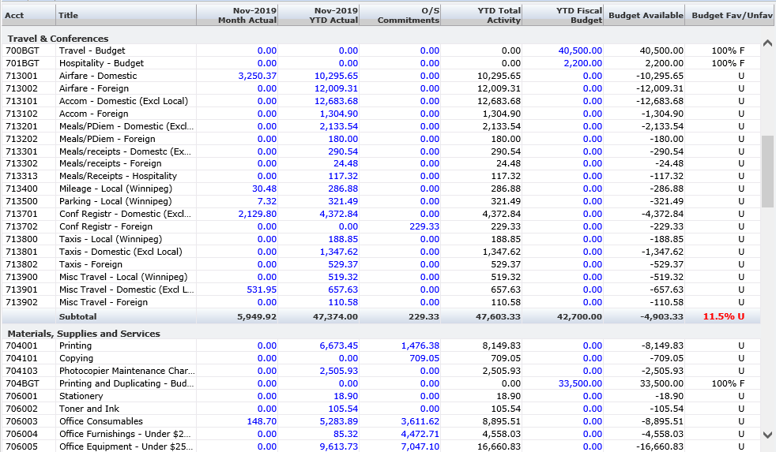
Identifying a Journal Entry
JVs
BTs

Slide 9
Journal Vouchers
In Banner, journal entries & ID charges are entered on a journal voucher page
FGAJVCQ
FGAJVCD
FGAJVCM

Slide 10
Debit or Credits?
Each record is either a Debit or Credit:
Expenditures
If increasing an amount – Debit
If decreasing an amount – Credit
Revenue
If increasing an amount – Credit
If decreasing an amount – Debit

Slide 11
Restrictions
Security rules
Gain access by completing the Aurora Finance Systems Access form
Capital Acquisition (>$2,500)
Account codes begin with 726
Land Building Acquisitions and Improvements
Account codes begin with 730
Salary, Benefits and Pay Levy Accounts
Begin with 6 (Completed in JUMP)

Slide 12
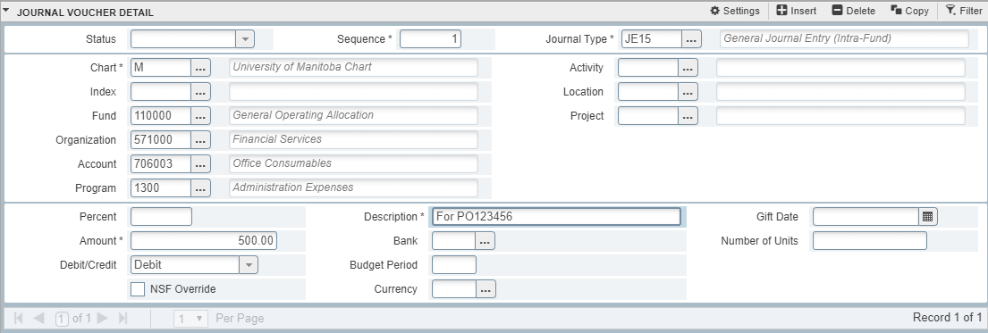
FGAJVCQ
Journal Voucher Quick Page
Most popular journal voucher page
Multiple screens to navigate
Displays titles of the chart of account elements used in the entries

Slide 13
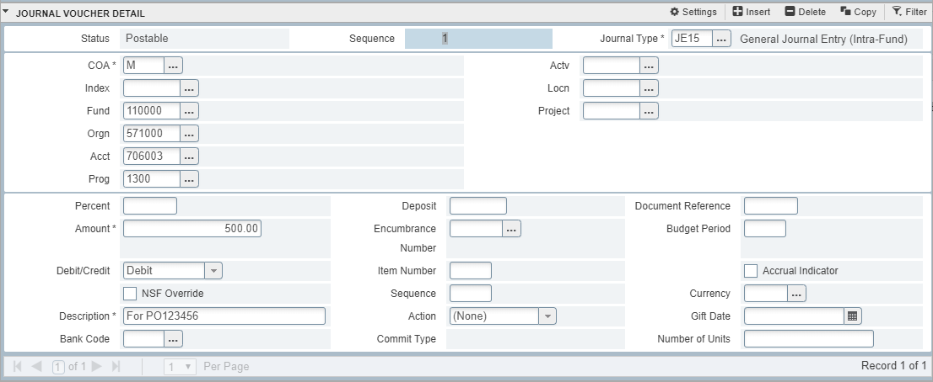
FGAJVCD
Journal Voucher Detail Page
Provides additional document reference field visible in FAST Reporting
Multiple screens to navigate
Different view/navigation from the Quick page
Does not display titles of chart of account elements

Slide 14
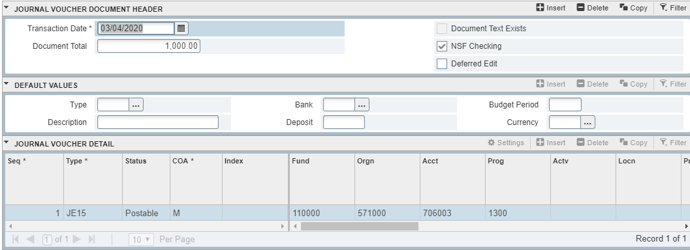
FGAJVCM
Journal Voucher Mass Entry Page
Single screen to navigate and view information
Ability to enter default values such as description, journal type and bank code

Slide 15
Journal Entry Exercises
FGAJVCQ – Exercise #1
FGAJVCD - Exercise #2
FGAJVCM – Exercise # 3

Slide 16
Journal Entry BACKUP
Backup should answer all these questions
Amount request transferred
Approval from financial authority that is being debited
Reasoning why entry to be done
This is the minimum standard
Invoice/Purchase Order Expense backup

Slide 17
Interdepartmental Charge
When do I use an ID Charge?
ID Charge = Interdepartmental Charge
Use when you need to charge another unit within the University for goods or services that is credited as revenue to your unit.
Different ID charge types used depending on which type of transaction is required.
Use when you need to charge a research project for a service your unit provided

Slide 18
ID Charge Rule Codes
ID1D used for debits to Account type 70 (expenditures)
ID1C used for credits to Account type 5D (Internal Sales & Service)

Slide 19
Internal Sales and Services
Internal Sales and Services are within the 5D account hierarchy:
53000x Internal Sales Income
53100x Internal Rental Income
53200x Internal Fee for Service
53300x Internal Rec Services Income
53450x Internal Other Income
53470x Internal Courses Conferences Workshops
And others…

Slide 20
IDC & Other Exercises
FGAJVCQ – Exercise # 4 & 5
Copy a JE/IDC – Exercise #6
Reverse a JE/IDC – Exercise #7

Slide 21
Journal Voucher Queries
Query a completed Journal Voucher in two ways:
Banner
FGIDOCR
Allows you to view the document once it’s been completed
FAST Reporting
Document Type Query
View the document the day after it’s been “posted” in Banner

Slide 22
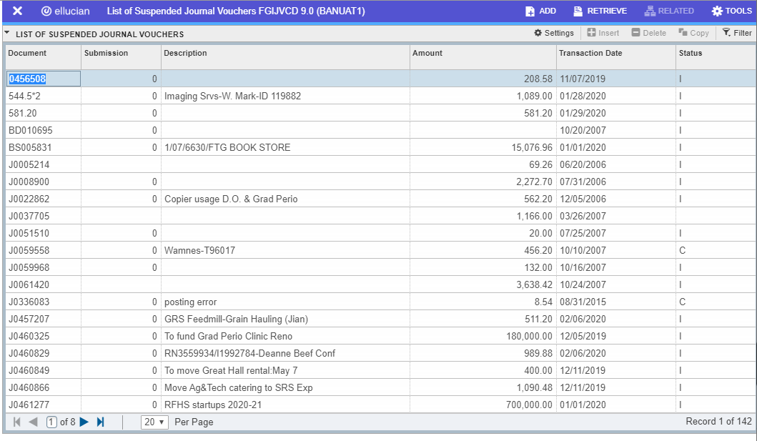
Journal Voucher Queries
Retrieve incomplete journal vouchers:
FGIJVCD
List of suspended / in progress documents
Query on date, amount, description or Doc # fields

Slide 23
Query Exercises
FGIDOCR – Exercise #8
FGIJVCD – Exercise #9

Slide 24
Summary
Journal Entries are to make corrections or adjustments
ID Charges are to charge another unit within the University for goods or services
There are 3 journal voucher pages that can be used:
FGAJVCQ, FGAJVCD, and FGAJVCM
Aurora Finance Systems Access form must be completed and submitted in order to gain access to create journal vouchers

Slide 25
Questions

Slide 26
Assistance
Need additional support?
Aurora Finance Customer Service Desk for system support at 204-480-1001 or aurora_finance@umanitoba.ca
Research Accounting and Financial Analysis and Reporting accountant listing at http://umanitoba.ca/admin/financial_services/budgrant/index.html
Guides, Manual & eLearns available on the Aurora Finance page
Visit the Aurora Finance website for training & resources
https://umanitoba.sharepoint.com/sites/um-intranet-aurora/SitePages/banner-finance.aspx
ASK Aurora! Sessions
Subscribe to our client mailing list to stay up to date!
https://lists.umanitoba.ca/mailman/listinfo/aurora-finance-users

Slide 27
Additional Training
Banner & FAST Training
Introduction to Aurora Finance
Aurora For Researchers
BANNER Navigation Fundamentals
Journal Entries & Interdepartmental Charges (JE’s & IDC’s)
Advanced FAST
External Invoicing (FAST A/R)
Budget Transfers
Concur
Travel and Expense Management
EPIC
Introduction to EPIC
EPIC – After the Order
EPIC Contracts
How many certificates can you achieve?

Slide 28
Thank you!

