Slide 1
EPIC Contract Request Training
WELCOME

Slide 2
Agenda
In this session we will :
Introduce the Contract Request Form & Process
Learn how to initiate & submit different types of Contract Requests
Service Agreements and Contracts
The Form vs. the Workspace
What you need
Getting started & submitting
Contract Set-up – what Purchasing Services will do
Learn about managing requests, invoices & contracts

Slide 3
Definitions
What is a Contract Request?
A form used to initiate the creation of a contractual agreement in EPIC that is completed by the Purchasing Services department
Used when there is an agreement between the University and a Supplier with anticipated variables
Price
Quantity
Scope of Work
Term

Slide 4
Definitions
Price
The final cost of the items and/or service
Quantity
How many items or amount of service required
Scope of Work
Clear description of what will be provided
Term
Defined timelines – start & end dates

Slide 5
When do I use?
There are two types of Contract Requests:
Service Agreements (non-individual)
University engages a supplier to perform defined services based on a mutually binding agreement
University’s standard terms and conditions agreement will be used
Contracts (Signed Agreements)
Supplier provides their own agreement to the University which is reviewed and approved
Such as Secondments, Construction projects & related agreements
And sometimes…
Department specific contracts e.g. specialized services

Slide 6
When do I use?
Price
Quantity
Scope
Term
No Changes
Potential Changes
Purchase Requisition
Contract Request
**Variances on invoices are acceptable
Considerations:
Purchase Orders cannot be amended/changed
Contracts can be amended/changed

Slide 7
When do I use?
Snow Removal
Snow Go will be doing snow removal for 2 years.
Services are to be provided within 12 hours of being contacted between the hours of 9pm–6am to minimize disruptions on campus.
The hourly rate is $89/hour & the quantity will vary depending on the snowfall and total hours required to complete the work.
Price | Quantity | Scope | Term | Which Form?
Yes
No
Yes
Yes
CR
Which type of contract request would this be?
Service Agreement

Slide 8
When do I use?
Microscope Purchase
You are buying a microscope from the ACME Company Ltd.
There is 1 microscope at the price of $175,000.
The agreement includes the microscope, delivery, installation, calibration, and training.
Expected delivery and set-up is 3 weeks.
Price | Quantity | Scope | Term | Which Form?
Yes
Yes
Yes
Yes
PR

Slide 9
When do I use?
Software Purchase
The University has purchased a new software. The cost is $300,000 for 3 years. The payments are:
Year 1 - $200,000 Year 2 - $50,000 Year 3 - $50,000
Costs include implementation & training.
A license cost of $150/person each year is expected & the number of licenses needed is not known.
The option to purchase 2 additional years is also available.
Price | Quantity | Scope | Term | Which Form?
Yes
No
Yes
No
CR
Which type of contract request would this be?
Contract

Slide 10
Contract Request Form & Workspace
Contract Request form
Where is the form
What you need before you start
What fields you need to complete
Contract Request Workspace
Your workspace and task list
Submitting your request

Slide 11
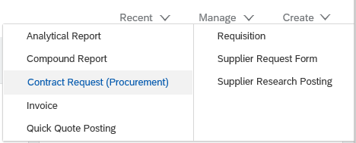
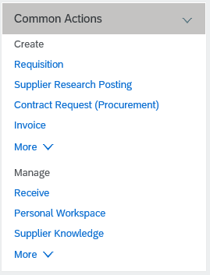
Contract Request Form & Workspace
You can access the Contract Request Form 2 ways:
Common Actions Create Menu

Slide 12
Contract Request Form & Workspace
What is needed for a Contract (Signed Agreement)?
Before you initiate your request in EPIC check:
Does Legal Counsel need to review the agreement?
Have all authorized signatures been obtained?
Contact Purchasing Services to guide you to the required forms for your agreement
For contract information, visit the webpage below: https://umanitoba.ca/admin/financial_services/purch/contracts.html

Slide 13
Contract Request Form & Workspace
Ready to start? Make sure you have what you need:
Scanned copy of the following documents:
Signed agreement
Any additional related documents
The total amount of the agreement
FOAP that will be used
Department Contact
Start and End dates of the agreement
Financial authority with EPIC access
Contract Contact

Slide 14
Contract Request Form & Workspace
Initial details that need to be completed are:
Name or Title of Request
Description of goods/services
Supplier
Contract Amount
Commodity
FOAP
Department Contact (name, address, phone number)
Start & end dates of the agreement

Slide 15
Contract Request Form & Workspace
A Workspace is created once you complete the form
The workspace is where the details are added and the request is submitted to Purchasing Services
This is where you will:
Attach a scanned copy of the Signed Agreement
Define who the Financial Authority is
Define the Contract Contact
Review all information
Submit request to Purchasing Services

Slide 16
Contract Request Exercise
EXERCISE 1 – Creating a Contract Request
Your area sends samples to an external lab on a regular basis for analysis. Sometimes this is daily but the timing is sporadic.
The individuals responsible for collecting and sending the samples are working directly in research facilities. Due to the sensitive timing required to transport the samples safely to the external lab you are unaware of the samples being sent until an invoice arrives.
Most sample analysis costs are between $30.00 and $150.00. In an average month there are 20 samples sent out. The estimated cost for a year is $125,000 and the supplier has provided an agreement to the research lab to manage these samples.
A contract request is needed because there are variables in the Price & Quantity of samples for analysis.

Slide 17
Contract Request Form & Workspace
What is needed for a Service Agreement?
Before you begin:
Obtain quotes from the Supplier
If above $25,000 contact Purchasing Services to discuss requirements
Description of Services
Human Resources Approval

Slide 18
Contract Request Form & Workspace
Description of Services
Defines what work the Supplier will be performing
What is the expected work schedule and deliverables from the supplier?
Be as thorough as possible
Outline all the required outcomes
If specific work needs to be completed prior to commencement of other work, define in document

Slide 19
Contract Request Form & Workspace
Human Resources (HR) Approval
Gaining approval from HR is the responsibility of the Faculty/Unit
Email the details of the work associated with the agreement to HR @
hrsvcagreements@umanitoba.ca
HR will review to determine if the work is deemed as employment or not

Slide 20
Contract Request Form & Workspace
HR Approval is not required for:
Purchases of Software Solutions that may include the Vendor supplying associated services such as:
Installation/implementation
System design
Data entry/migration
Integration with third-party software
Training

Slide 21
Contract Request Form & Workspace
Ready to start? Make sure you have what you need:
Scanned copy of the following documents:
Description of services
HR Approval
Any additional related documents
The total amount of the agreement
FOAP that will be used
Itemized additional costs and amounts (if applicable)
Department Contact
Start and End dates of the agreement
Financial authority with EPIC access
Contract Contact

Slide 22
Contract Request Form & Workspace
Initial details that need to be completed are:
Name or Title of Request
Description of goods/services
Supplier
Contract Amount
Are additional expenses applicable to this agreement
Commodity
FOAP
Department Contact (name, address, phone number)
Start & End dates of the agreement

Slide 23
Contract Request Form & Workspace
A Workspace is created once you complete the form
This is where you will:
Attach a scanned copy of the Description of Services and HR Approval
Define who the Financial Authority is
Define the Contract Contact
Review all information
Submit request to Purchasing Services

Slide 24
Contract Request Exercise
EXERCISE 2 – Creating a Contract Request
Your Faculty will be hosting multiple events that will include many community leaders. In order to ensure the safety of all participants AlliedBarton Security Services is being hired for the events.
The term of the agreement is September 30 to March 31.
The amount of the contract is not to exceed $500,000.00.
The number of guards required for each event will be determined as event registration is finalized. Invoices will vary based on the size of event and number of guards required.
Description of Services form has been completed and HR approval has been obtained.

Slide 25
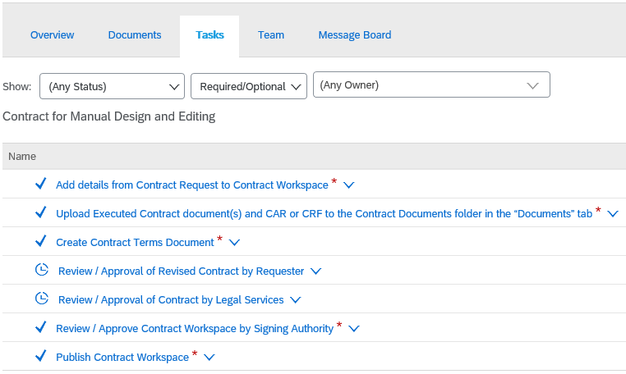
Contract Set-up
There is no approval by the financial authority on a Contract Request
Additional approvals & review occur through the steps Purchasing Services manages

Slide 26
Contract Set-up
Purchasing Services will review your request and will initiate the Contract process
When the workspace is complete, Purchasing creates a Contract Terms document
These documents begin with a C followed by a numeric e.g. C34509
The Contract Terms document is sent to the supplier
Commitments & invoices are applied to the Contract Terms document

Slide 27
EPIC and Financial Systems
Contracts displayed in FAST will refer to the BANNER Encumbrance #, the Contract ID from EPIC
To obtain additional information on the Contract and related invoicing = use the report in EPIC

Slide 28
Managing Contract Requests & Contracts
Editing
You can edit any of the contract request content while it is still in any of the approval processes.
Withdrawing
You can withdraw an approval before it is complete.
Closing a Contract Request
You can close a request before is fully approved.
If the task is still listed as In Approval or Draft then the close function can be used
A fully approved request cannot be edited, withdrawn or closed

Slide 29
Contract Request Exercise
Locate your request for AlliedBarton Security Services
Edit
Change the FOP to 307899-340400-2200
Hint Edit the Contract Attributes
Change the Title
Hint Edit the Overview
Withdraw
Withdraw the Purchasing Approval
Hint This is a pending task
Close
Close the request
Hint Edit the Overview tab

Slide 30
Managing Contract Requests & Contracts
Contracts can be changed these are called Amendments
You may require an Amendment to:
Increase dollar amounts
Change the scope of work
Update the term
Change the FOAP
Amendments are requested through the Contract Request form

Slide 31
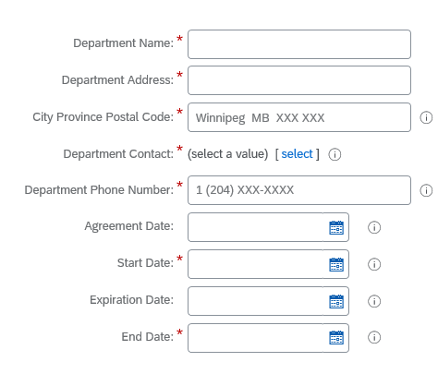
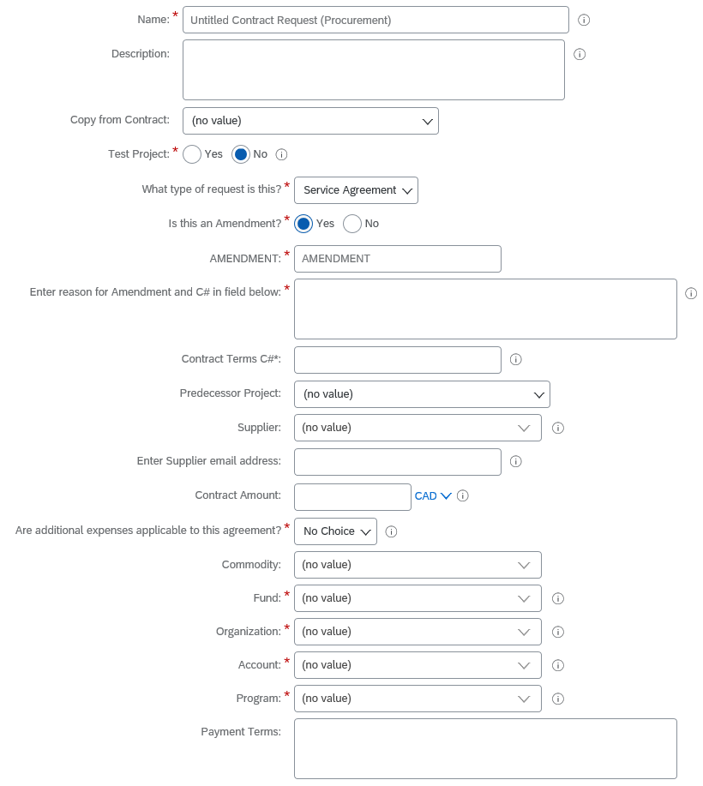
Managing Contract Requests & Contracts
Use the copy field to fill in the form
Amendment field YES
Fill in with what is changing
Auto populates to feed final agreement
Insert the date the Amendment starts
Provide the C #
Update fields to show the changes
e.g. Amount, End date etc.
Similar to the copy field. Connects the dots in the background

Slide 32
Managing Contract Requests & Contracts
Amendments can only be requested on contracts that have already been created in EPIC
The original requester owns the document and is the person who can do this in the system
4 IMPORTANT fields:
Populate the “Copy from Contract” field
Select Yes for “Is this an Amendment?” field
Fill out “Enter reason for Amendment and C# field below”
Populate “Predecessor Project” field
Change the values in the fields to be amended
Complete all tasks and submit to Purchasing Services for review/approval

Slide 33
Approving an Invoice
There is no receiving on Contracts
Invoices must be approved by the Contract Contact
Notification that an invoice is pending your review will appear in your To Do box
To review the invoice in EPIC, select APPROVE from your To Do box or OPEN from the email

Slide 34
Approving an Invoice
The approval occurs on the IR document.
When you open your invoice you will see the contract #, supplier and total amount
You can also view a PDF of the actual invoice

Slide 35
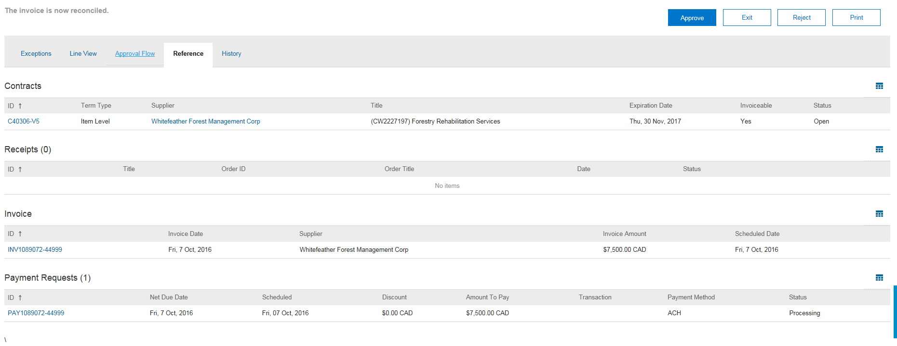
Approving an Invoice
If you wish to see the details of the invoice that was entered or the related contract use the Reference tab

Slide 36
Approving an Invoice
Ready to Approve the invoice for payment? Select the Approve button.
Payments are not released on unapproved invoices.
There is one tax exception that can delay your ability to approve a pending invoice in your To Do box. SPS will correct these – if you don’t see the Approve button please check back the next day.

Slide 37
Approving an Invoice
What if the invoice is incorrect or the work is not done?
If you are waiting for the work to be completed
Add a comment in EPIC
Wait and approve the invoice as soon as payment can be processed
Errors on the invoice? Payment will never occur?
Contact the Supplier to obtain a credit & corrected invoice
Send updated documents to Supplier Payment Services to process
Approve original invoice after credit is inputted.

Slide 38
Contract Reports
Reports provide you the visibility of who owns the contract, what FOAP was applied, remaining amounts, invoicing and much more!
Key reports for the Contract process are:
My Open Contracts
What contracts are open that I own?
What contracts are open for my department?
Contract Amount Left
How much is left on a contract?
Invoice Summary Report by Contract
What invoices have been applied to a Contract?

Slide 39
Hints & Tips
Remember to measure price, quantity, scope & term – will any of these change?
Include all documentation in your request to reduce delays
The Task tab is your checklist – do every one!
Double check your information – If you need to edit a submitted request check the approval first!
If you have changes to a contract, submit a contract request to Amend the contract.
Approve your invoices to process payments on time
Use reports to help manage the process!

Slide 40
Questions

Slide 41
EPIC Training
Introduction to EPIC
This 3 hour session introduces you to the basics of requisitions and navigating EPIC. This session is required to obtain access
EPIC – After the Order
This 2 hour session takes you to the next step and and is highly recommended for new clients. We will look at Managing Purchases & Receiving, Invoice Reconciliations and Tracking orders & Reporting
Contract Requests
This 3 hour session provides hands on practice with the Contract Request process. Learn how to set up contract agreements in EPIC, approve invoices and manage the documents related to a contract.

Slide 42
Additional Training
More Aurora Finance Training Opportunities
Banner & FAST Training
Introduction to Aurora Finance
Aurora For Researchers
BANNER Navigation Fundamentals
Journal Entries & Interdepartmental Charges (JE’s & IDC’s)
Advanced FAST
External Invoicing (FAST A/R)
Budget Transfers
Concur
Travel and Expense Management
How many certificates can you achieve?

Slide 43
Assistance
Need additional support using EPIC?
Aurora Finance Customer Service Desk for system support at 204-480-1001 ext. 2 or epic@umanitoba.ca
Guides, Manual & eLearns available on the Aurora Finance page
Purchasing Services for supplier negotiation or process guidance 204-474-8348 or purchasing@umanitoba.ca
Purchasing Policy http://www.umanitoba.ca/admin/governance/media/Purchasing_Procedures_-_2015_07_13.pdf
Supplier Payment Services for inquiries regarding supplier invoices, credits or payments, (see webpage for contact)
ASK Aurora! Sessions

Slide 44
Thank you!

