Slide 1

Banner Navigation

Slide 2
Agenda
In this session we will look at:
  What is Banner
  Banner Access
  Explore Banner
  Additional Functions

Slide 3
Expectations
By the end of today’s session, you will be able to:
  Log in to Banner aka ‘Aurora Admin’
  Navigate within Banner
  Use pages to query for specific information

Slide 4
Banner
What is Banner?
  Main engine of the Aurora Finance system
    Core component of our accounting system
    Records every financial transaction
  Various systems are connected to Banner in order to feed and/or pull information

Slide 5
Banner Access
Gaining access to Banner
  Complete the Aurora Finance System Access Form
Three types of access
  Query
    View information in pages
  Posting
    Ability to create transactions
  Both Query and Posting

Slide 6
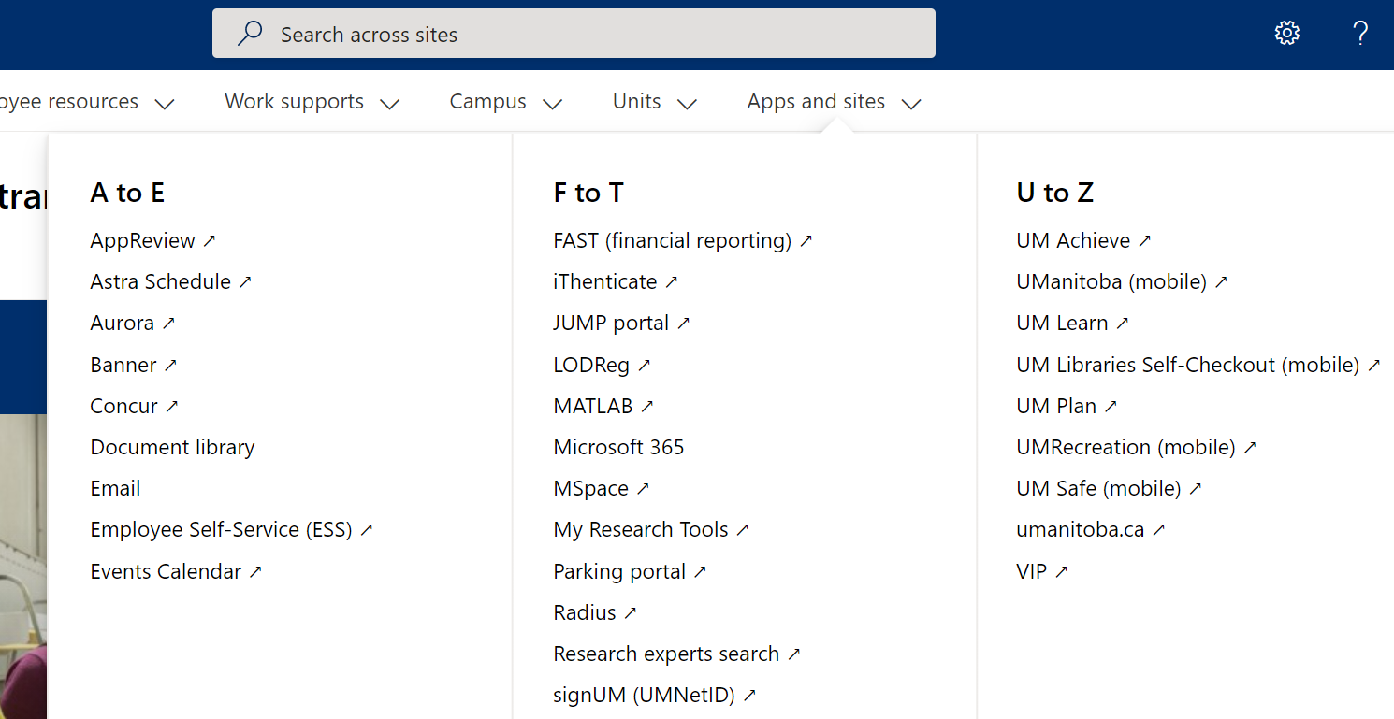
Logging in to BANNER
From the UM Intranet page
  1. Hover your mouse over Apps and sites.
  2. Click on Banner.

Slide 7
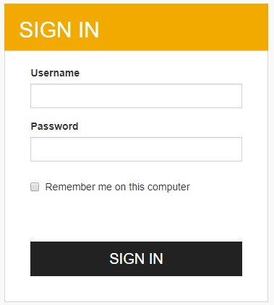
Logging in to BANNER
The Banner login screen will display:
  Enter your Finance User ID and password
  Select Sign In

Slide 8
Banner Structure
Aurora Finance
Module
Page
Page
Key Block
Module
Section
Record
Structure of Banner

Slide 9
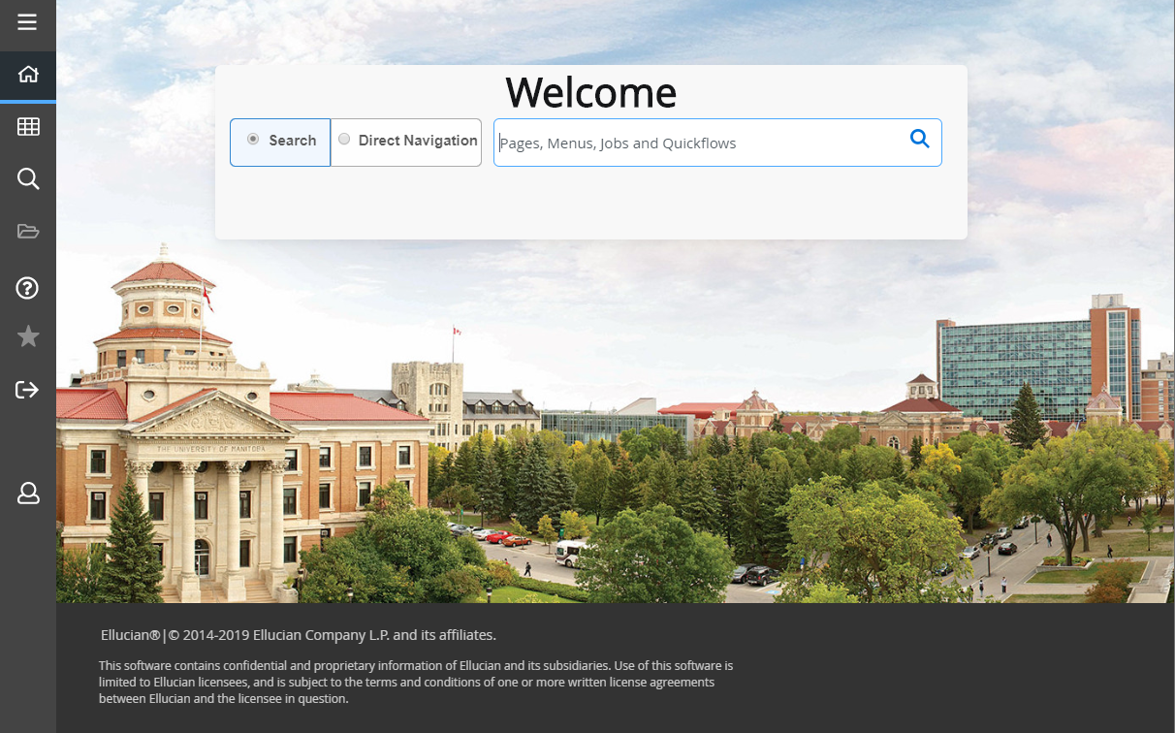
Banner
Main Menu Panel
Search Bar

Slide 10

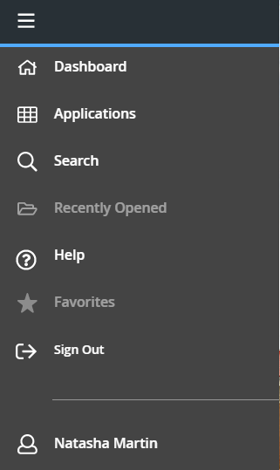
Navigation
Main Menu Panel
  Quick access to functions in the system
  Stays in place throughout navigation

Slide 11
Navigation
Dashboard
  Returns you to the homepage
Applications
  Access Banner, My Banner, My Links
Search
  Look up pages
Recently Opened
  Lists the pages that you have visited during your session
Help
  Software provider’s documentation
Favorites
  Mark pages from My Banner as Favorites to be easily accessible
Sign Out
  Logs you out of the system

Slide 12
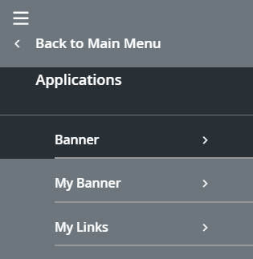
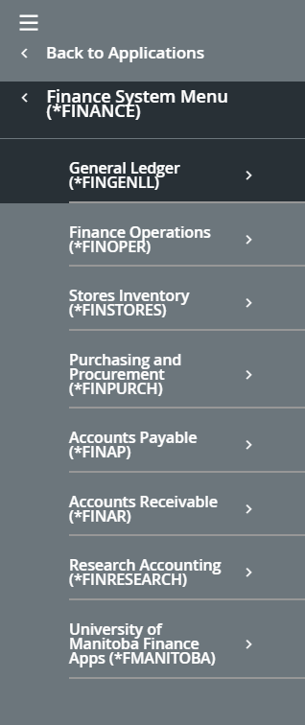
Accessing Pages
Applications
  Banner
    Access to Modules and Pages:
      Student, Finance, General
      Menus identified by asterisk (*)
      Pages contain no asterisk
  My Banner
    Add pages that you frequently use
    Mark with a star to add to Favorites list
  My Links
    Create your own quick links list

Slide 13
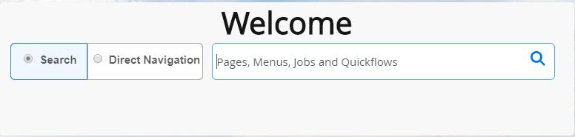
Accessing Pages
Search Bar
  Access pages directly through these options:
    Search
      Type in the related function for the page you are looking for
    Direct Navigation
      Type in the acronym of the page

Slide 14


Navigation
Buttons for Navigation
Short cut keys are available
Go – Retrieve information
Previous/Next Section – View the next section of information
Start Over – Search for a new document while remaining in the same page
Filter/Filter Again – Provides options for search fields

Slide 15



Navigation
Message Centre
  Provides hints, errors and success notifications when working in pages.
    Green is informational
    Yellow is a warning
    Red is an error

Slide 16

Navigating Pages
Menu bar
  Add and Retrieve
    Banner Document Management.
  Related
    List of other pages relating to the information you are viewing in a current page such as Document Text.
  Tools
    Options and actions that can be performed on the current page such as clear record or print.

Slide 17
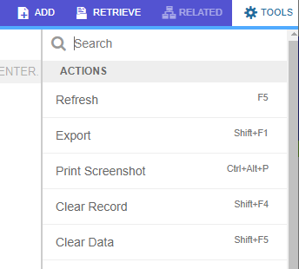
Additional Functions
Customize your pages
  Reorder columns or rows
  Select your choice of filter options
  Choose the amount of results to display
  Save your preferences or restore them to the default settings
Print Screenshot
  From Tools, print exactly what you see on your screen

Slide 18
Page Acronym
Journal Voucher Quick Page
FGAJVCQ
F – Financial System
G – General Accounting Module
A– Type of Page – Application
JVCQ – shortened version of page name

Slide 19
Page Types
Application:
  Used to create a document or to add, change or delete information in a page
    FGAJVCQ, FTMVEND
Query:
  Used only to view information. For example, to view a list of journal vouchers that are incomplete
    FOIDOCH, FTVVEND

Slide 20
FAIINVE
FAIINVE – Invoice Query
  Use to query Banner invoices that begin with an “I”
    Provides the following information:
      System contract reference number (if it exists)
      FOAP(AL) detail
      Vendor invoice date and number

Slide 21
FGIDOCR
FGIDOCR – Document Query Screen
  Use to query all Banner documents
    Best used for journal entries and ID charges
    Provides the following information
      ALL debit and credit records (unavailable in FAST)
      Associated text (if it exists)

Slide 22
FYMFORS
FYMFORS – Financial Authority Query
  Use to query Financial Authorities on a fund, for a department/organization code
    Provides the following information
      Financial Authorities
      Financial Services representative
http://umanitoba.ca/admin/financial_services/budgrant/signing_authorities.html

Slide 23
Exercises
FAIINVE - Exercise #1, #2
FGIDOCR - Exercise #3, #4
FYMFORS - Exercise #5, #6, #7

Slide 24
FRIGRNT
FRIGRNT – Grant Information Query
  Use to query a specific grant fund
    Provides the following information
      Principle Investigator name
      Granting Agency
      Responsible Organization
      Amount of grant (if provided)
      End date of grant (if provided)

Slide 25
FTMFUND
FTMFUND – Fund Query
  Use to query the predecessor on a fund
    Provides the following information
      Predecessor
      Fund Type
      Default Organization and program
      Date of entry into the system

Slide 26
FAIVNDH
FAIVNDH – Travel Claim Query
  Use to query the status of a travel claim using an employee or student number
    Provides the following information
      Travel claim / Reference number
      Banner invoice #
      Status
      Cheque date
      Cheque number

Slide 27
Exercises
FRIGRNT - Exercise #8, #9
FTMFUND - Exercise #10, #11
FAIVNDH - Exercise #12, #13

Slide 28
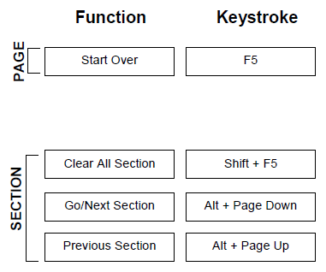
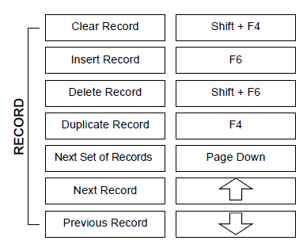
BANNER Short Cut Keys
Check your manual for a complete list of shortcut keys

Slide 29
Summary
All financial transactions are recorded in Banner
Access is granted through the Aurora Finance Systems Access request form
Navigate to pages through the Main Menu Panel or Search Bar
Use various pages to query for information on documents, transactions and funds

Slide 30

Questions

Slide 31
Additional Training
  Banner & FAST Training
    Introduction to Aurora Finance
    Aurora For Researchers
    BANNER Navigation Fundamentals
    Journal Entries & Interdepartmental Charges (JE’s & IDC’s)
    Advanced FAST
    External Invoicing (FAST A/R)
    Budget Transfers
  Concur
    Travel and Expense Management
  EPIC
    Introduction to EPIC
    EPIC – After the Order
    EPIC Contracts
How many certificates can you achieve?

Slide 32
Assistance
Need additional support?
  Aurora Finance Customer Service Desk for system support at 204-480-1001 or aurora_finance@umanitoba.ca
  Guides, Manual & eLearns available on the Aurora Finance page
    Visit the Aurora Finance website for training & resources
    https://umanitoba.sharepoint.com/sites/um-intranet-aurora/SitePages/aurora-finance-overview.aspx
  ASK Aurora! Sessions
  Subscribe to our client mailing list to stay up to date!
    https://lists.umanitoba.ca/mailman/listinfo/aurora-finance-users

Slide 33
Thank you!

