Slide 1
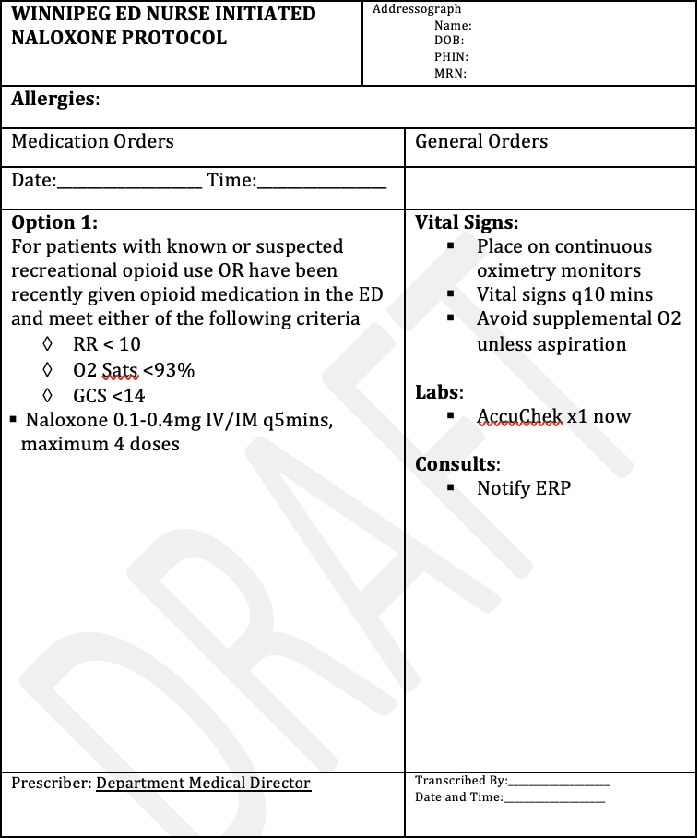
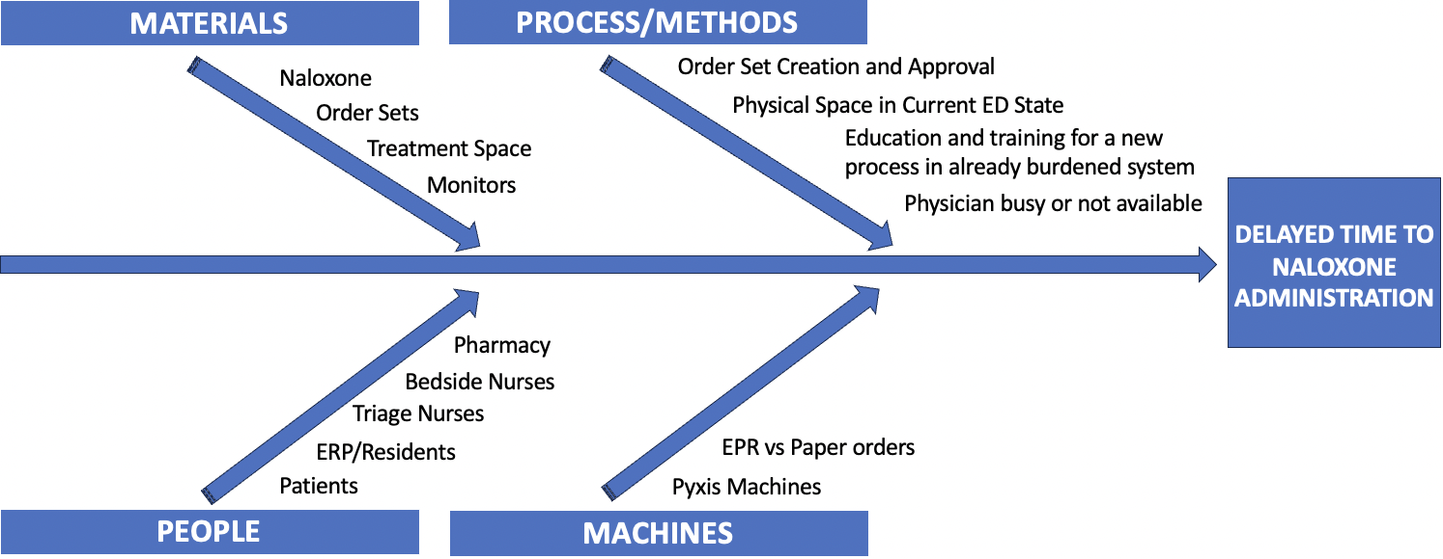
RFHS / Max Rady College of Medicine
Nurse Initiated Naloxone in the Emergency Department
Brueton-Campbell, L., Hrymak, C.
Department of Emergency Medicine, University of Manitoba
PROBLEM
AIM STATEMENT
BARRIERS
Many patients in Winnipeg EDs present with either illicit or prescribed opioid use. Based on recent Manitoba epidemiological data (Nov 2022), there are >200 visits per quarter¹ for opioid related visits (approximately half the amount of visits for stimulant intoxication).
Currently, Naloxone for patients with suspected opioid overdose requires a physicians order which may result in delays to treatment.
By March 2024, we aim to have implementation of a standard nurse initiated Naloxone order set in both Winnipeg tertiary Emergency Departments (HSC and SBGH).
OUTCOME MEASURES:
Time to treatment with Narcan, nurse satisfaction with intervention and impact on nurse workload
PROCESS MEASURES:
Number of documented uses of set
BALANCING MEASURE:
Precipitation of withdrawals, time involved with using set/nursing resources
Opioid toxicity is a frequent presentation¹ in Winnipeg EDs, and treatment requires a physicians order. If physicians are not readily available this could lead to delays to treatment with naloxone
Naloxone can be given outside of hospital by EMS, nurses in specific situations. It can also be accessed by any individual at pharmacies/safe dispensing sites and requires minimal training in order to use
Few very side effects with low dose naloxone, and very unlikely to precipitate harm in hospital setting²
Trials from Australia suggest that standard orders improve care of patients with opioid toxicity in the ED³
May be underreported as data based on ED discharge codes⁴
Educational barriers – multiple involved parties including triage nurses, bedside nurses, nurse educators, pharmacy all of whom need to be familiar with a new process
Location of Naloxone; will require a Pyxis override
Potential to add to burden of already heavy nursing workload
May delay assessment by ERP
Difficult to track outcomes such as time to treatment with Naloxone, in previous studies time from presentation to Naloxone did decrease, but not significantly³
MEASURES
RATIONALE
Figure 2: Ishikawa diagram showing potential causes for why there may be delays to treatment with Naloxone
REFERENCES
Government of Manitoba, Department of Health, Performance and Oversight Division, Epidemiology and Surveillance. (2022). Take Home Naloxone Program and Substance Surveillance Report: December 2022.
Wermeling DP. Review of naloxone safety for opioid overdose: practical considerations for new technology and expanded public access. Ther Adv Drug Saf. 2015 Feb;6(1):20-31.
Isoardi, K., Learmont, B., Horan, B. and Isbister, G. (2023), Dedicated nursing care pathway improved management of opioid-poisoned patients in the emergency department: A before–after observational study. Emergency Medicine Australasia, 35: 69-73
Federal, provincial, and territorial Special Advisory Committee on the Epidemic of Opioid Overdoses. Opioid- and Stimulant-related Harms in Canada. Ottawa: Public Health Agency of Canada; March 2023
Figure 1: Example of a standard nurse initiated order set for administration of Naloxone in the ED

