Slide 1
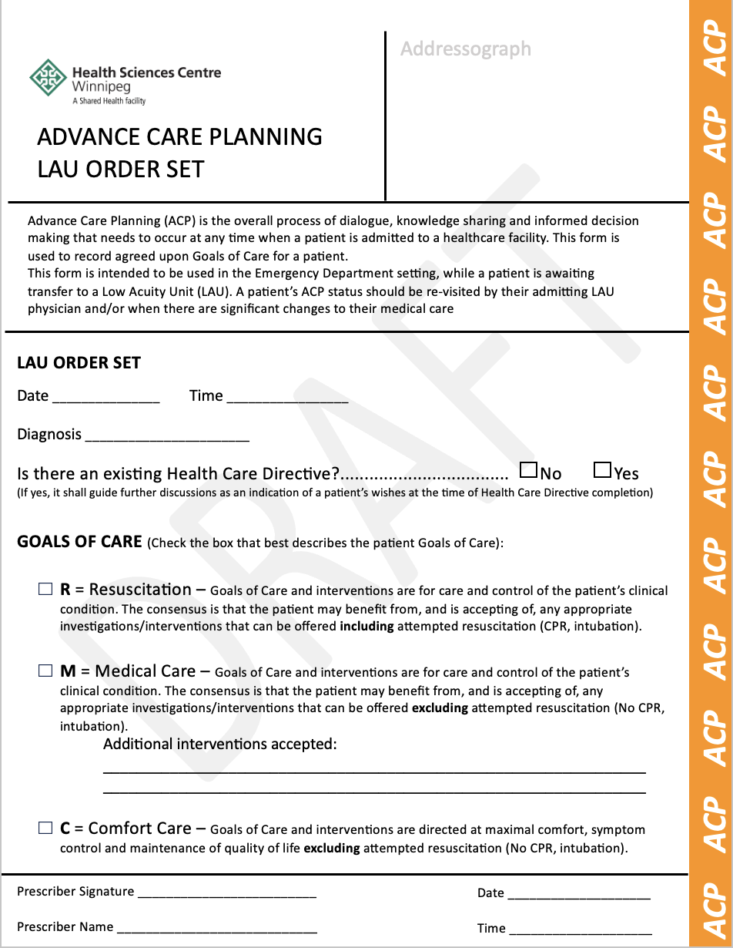
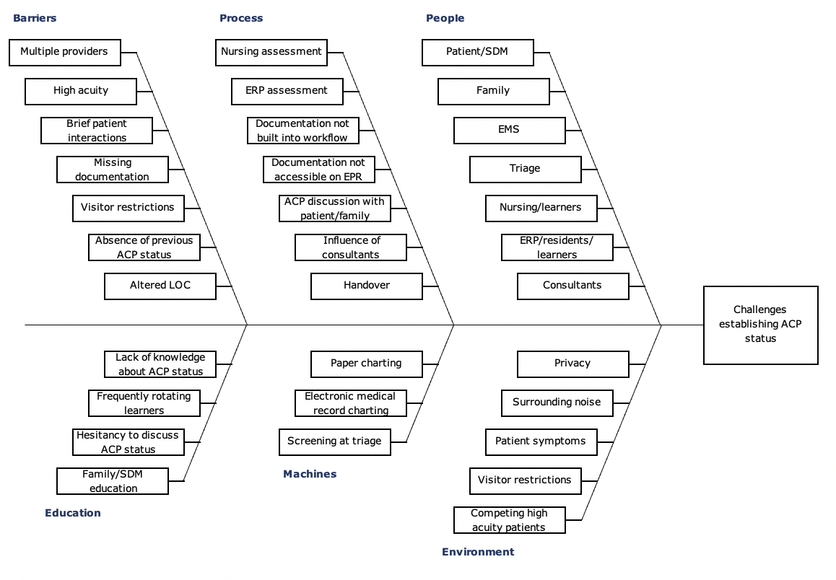
RFHS / Max Rady College of Medicine
Improving ACP Status Documentation in LAU Patients
How the development of an ACP Status LAU Order Set could improve patient care
Emily Stoneham, MD
Department of Emergency Medicine, University of Manitoba
PROBLEM
Patients do not always have a previously documented Advanced Care Plan (ACP) status when they present to the emergency department (ED)
Access block has increased the number of patients awaiting placement in the ED – specifically, increased numbers of patients are awaiting Alternate Level of Care (ALC) beds in a Low Acuity Unit (LAU)
Patients with advanced directives are more likely to receive medical care in line with their wishes¹
Advanced directives improve satisfaction that family members have with a patient’s care¹
MEASURES
A retrospective chart review of all patients flagged for LAU will be performed to assess when their ACP status documentation was filled out. ACP status documents will request date and time be filled out as with any other order set. This date and time will be compared to the time that patients were flagged for LAU in the EPR.
Outcome Measures:
Percentage of patients in the ED who have appropriate ACP documentation within 12 hours of being flagged for LAU
Number of patients who are transferred to LAU without an ACP status document completed and placed on the patient chart
Perceived provider satisfaction with ACP status documentation in patients flagged for LAU
Process Measures:
Number of patients who are flagged for LAU who have their ACP status documents completed by a physician within 12 hours of being flagged for LAU
Availability of ACP status documentation forms in the ED at all times
Provider Measures:
Survey submitted to nursing, ERPs, and residents working in the ED to assess satisfaction with ACP status documentation/ perceived barriers to completing ACP forms for patients flagged for LAU
AIM STATEMENT
To ensure that 90% of patients who are flagged for LAU in the emergency department have an ACP status documented on their current ED visit chart, within 12 hours of being flagged for LAU, by July 1, 2024.
Figure 2. Proposed ACP LAU Order Set for use in patients flagged for LAU in the ED
EXPECTED BENEFITS
Consistent ACP documentation
Improved patient care – providing care in line with patient values
Improved patient and family understanding of goals of care
Improved patient and caregiver/family satisfaction with health care delivered in the ED
Easy access to documentation regarding patient goals of care in the event of patient deterioration while in the ED
BARRIERS
Adoption requires ongoing engagement by key stakeholders
Adoption requires regular use of paper documentation at facilities with electronic medical records
REFERENCES
1. Walter KL, Joehl HE, Alrifai T, Varghese TG, Tyler MJ. A Quality Improvement Initiative to Increase Completion and Documentation of Advanced Directives in the ICU at a U.S. Community Teaching Hospital. Crit Care Explor. 2021 May 6;3(5):e0413. doi: 10.1097/CCE.0000000000000413. PMID: 33977277; PMCID: PMC8104255.
Figure 1. Ishikawa diagram outlining challenges in establishing ACP status in patients in the ED
ACKNOWLEDGEMENTS
Thank you to Dr. Carmen Hrymak for her support and guidance in the development of this project!

