Slide 1
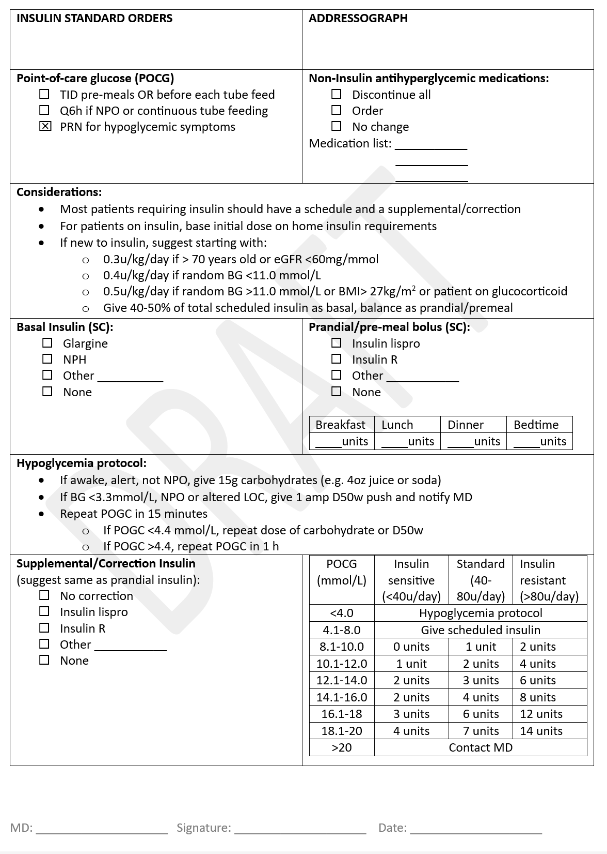
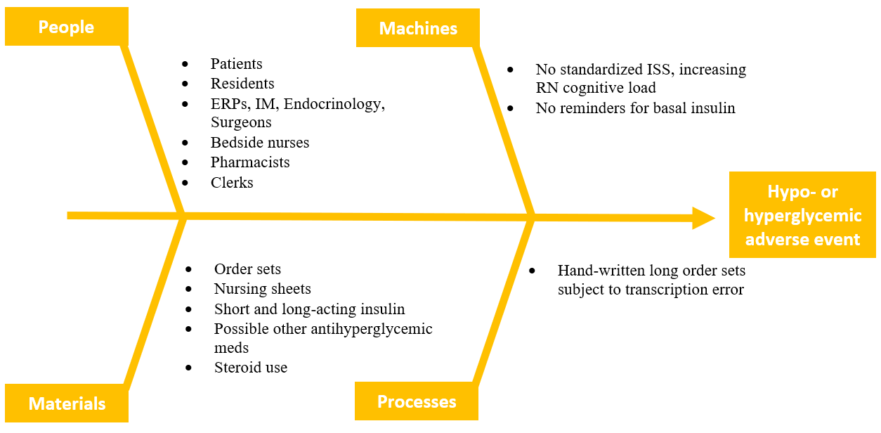
RFHS / Max Rady College of Medicine
Development of an insulin sliding scale standard order set for
non- critically ill patients at HSC
Devon Johnstone MD/PhD, Carmen Hrymak MD FRCPC
Department of Emergency Medicine, University of Manitoba
PROBLEM
Poor glycemic control is associated with outcomes such as slow wound healing, infections and mortality for in-patients
Patients in the emergency department as well as on the wards with or without a history of diabetes often are prescribed a temporary insulin sliding scale (ISS) for glycemic control, either in addition to or as a replacement of home antihyperglycemic regimens
In multiple other institutions, standardized ISS protocols exist to minimize medication error and adverse events, but no such protocol exists at HSC
The current system at HSC requires physicians to manually write out a long order set each time, leading to potential significant inter-prescriber variation as well as errors, and often a lack of basal insulin orders which could be beneficial
Transcribing these long handwritten prescriptions further risks errors, and there are risks of hypo- or hyperglycemia and subsequent complications
FUTURE CONSIDERATIONS
In addition to designing a standard ISS protocol for HSC, in collaboration with Endocrinology there is consideration of expanding further to create order sets for the management of DKA at HSC and the WRHA
Figure 2: Ishikawa diagram identifying factors leading to glycemic related adverse events in hospital
INTERVENTION
To develop a standardized order set and nursing flow-sheet for ISS, following diabetic guidelines and in consultation with Endocrinology
AIM STATEMENT
The HSC ISS order set is to be completed and in use in the ED and hospital with at least 75% usage rate for when ISS are ordered, by June 2024.
Figure 1: Draft of standardized insulin orders including sliding scale
MEASURES
Outcome measures: hypo- and hyperglycemic events, physician and nursing satisfaction with improved workflow
Process measures: prescriber/transcription errors
Balancing measures: nursing workload with a new order set
REFERENCES
Donihi AC et al (2006) Use of a standardized protocol to decrease medication errors and adverse events related to sliding scale insulin. Qual Saf Health Care 15:89-91.
Colunga-Lozano LE et al (2018). Sliding scale insulin for non-critically ill hospitalized adults with diabetes mellitus (Review). Cochrane Database of Systematic Reviews, Issue 11 Art CD011296
Lee YY et al (2015) Sliding-scale insulin used for blood glucose control: a meta-analysis of randomized controlled trials
Miller D, Malcom J, Yu C (2018) Insulin Orders Sets & In-Hospital Management of Diabetes. Diabetes Canada.

