Slide 1
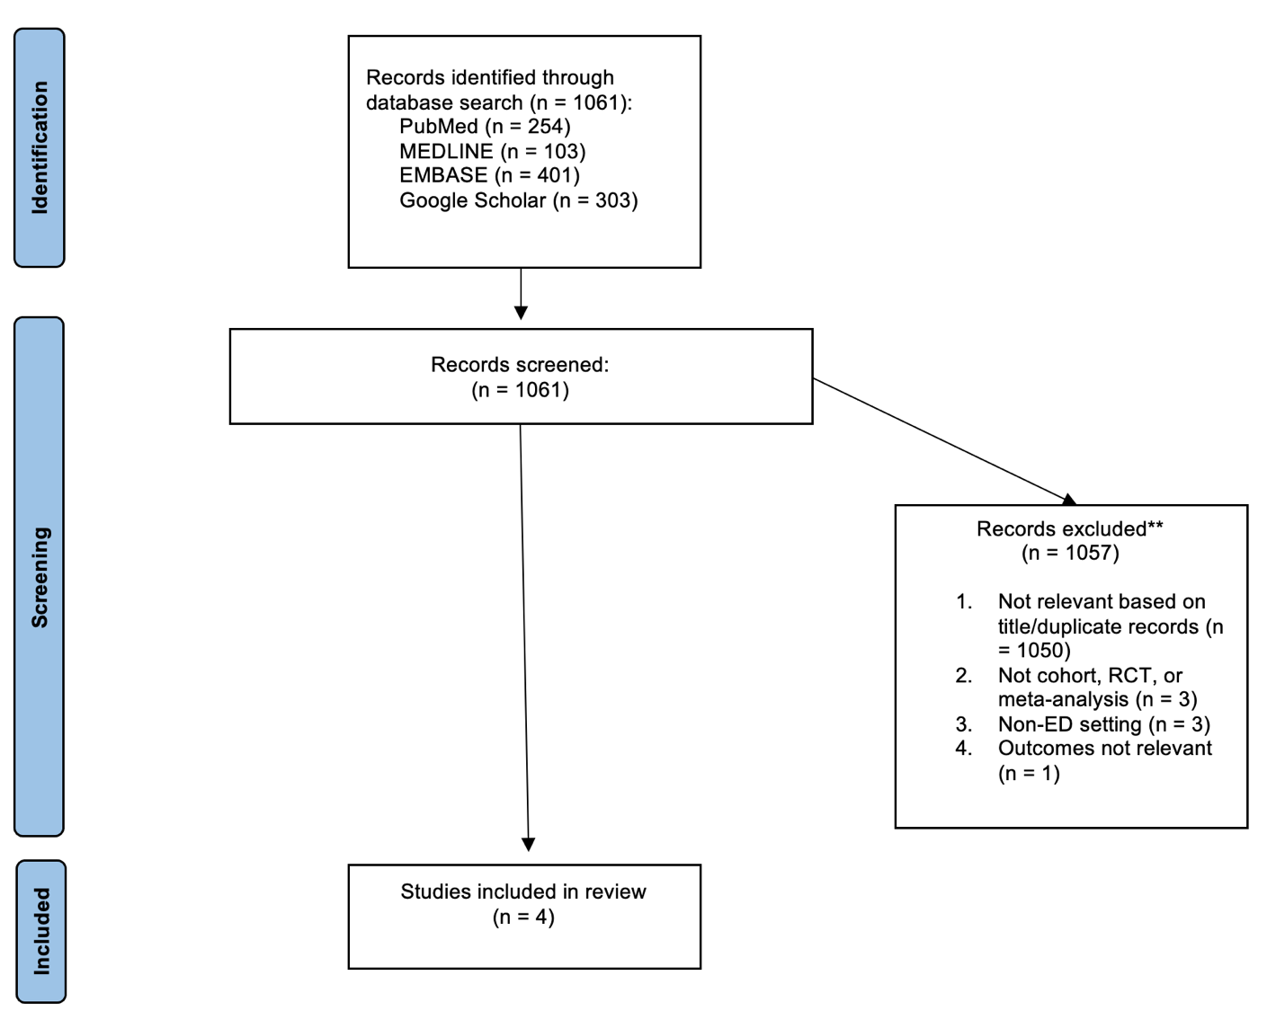
RFHS / Max Rady College of Medicine
Reduced-dose vs. 10-unit insulin dosing in hyperkalemic ED patients
Christopher Dutka
PGY-1 Emergency Medicine
INTRODUCTION
Hyperkalemia is a commonly encountered problem that has been associated with increased mortality amongst patients with and without renal dysfunction.
In Manitoba, given the high burden of chronic kidney disease and end-stage renal disease, hyperkalemia and hyperkalemic emergencies are frequently encountered in the ED.
Intracellular shifting of potassium using IV insulin R is the mainstay of hyperkalemia treatment, and variable dosing regimens have become apparent. Previously established guidelines suggested treating with anywhere from 10-20 units of IV regular insulin. Many practitioners utilize this traditional approach to insulin dosing – particularly Insulin R 10-unit IV bolus – while others opt for a reduced-dose strategy such as a 5-unit bolus.
While the hypokalemic effect of insulin is critical to mitigating mortality in hyperkalemic patients, iatrogenic hypoglycemia is also associated with increases in in-hospital and post-admission mortality.
Thus, a reduced dose insulin administration strategy may confer a safety benefit.
METHODS
Comprehensive literature search of multiple databases including PubMed, MEDLINE, EMBASE and Google Scholar
Articles screened for relevance based on their titles, and duplicates were filtered out.
Included studies must have compared insulin dosing regimens in hyperkalemic patients, with or without renal disease, in the emergency department setting
4 articles were selected for analysis, all of which were retrospective cohort studies:
LaRue HA, Peksa GD, Shah SC. A Comparison of Insulin Doses for the Treatment of Hyperkalemia in Patients with Renal Insufficiency
Keeney KP, Calhoun C, Jennings L, Weeda ER, Weant KA. Assessment of intravenous insulin dosing strategies for the treatment of acute hyperkalemia in the emergency department.
Moussavi K, Nguyen LT, Hua H, Fitter S. Comparison of IV Insulin Dosing Strategies for Hyperkalemia in the Emergency Department.
Finder SN, McLaughlin LB, Dillon RC. 5 versus 10 Units of Intravenous Insulin for Hyperkalemia in Patients With Moderate Renal Dysfunction.
RESULTS
LaRue et al.
Comparison: 5-unit vs. 10-unit
Incidence of hypoglycemia: 19.5% vs. 28.6%
Potassium reduction: -1.0 +/- 0.8 vs. -1.0 +/- 0.7
Statistically significant reduction in hypoglycemia without a significant difference in serum potassium reduction
Keeney et al.
Comparison: 5-unit vs. 10-unit
Incidence of hypoglycemia: 6.1% vs. 15.6%
Potassium reduction: -1.17 +/- 0.87 vs. -1.13 +/- 0.83
Statistically significant reduction in hypoglycemia without a significant difference in serum potassium reduction
Moussavi et al.
Comparison: <10-unit vs. 10-unit
Incidence of hypoglycemia: 11.2% vs. 17.6%
Potassium reduction: -0.94 +/- 0.71 vs. -1.11 +/- 0.80
Statistically significant reduction in hypoglycemia with a significant difference in serum potassium reduction
Finder et al.
Comparison: 5-unit vs. 10-unit
Incidence of hypoglycemia: 6.5% vs. 8.4%
Potassium reduction: -0.63 +/- 0.57 vs. -0.9 +/- 0.93
No significant difference in hypoglycemia with a significant difference in serum potassium reduction
All of the studies were well-balanced with respect to potential confounders and patient characteristics.
All of the studies were limited by their retrospective nature, and one study had incomplete outcome data with respect to potassium reduction.
CONCLUSIONS
Two of four studies analyzed support the use of a reduced-dose insulin strategy in hyperkalemia, however the conflicting evidence of the other two studies as well as the retrospective nature of all the studies weaken the evidence.
Thus, further prospective studies are needed to support a paradigm shift to the exclusive use of a reduced-dose insulin strategy in hyperkalemic ED patients.
RECOMMENDATION
Practitioners may decide to use a reduced-dose insulin strategy in certain situations
If choosing to do so, consider factors such as:
severity of hyperkalemia
renal dysfunction.
If choosing a reduced-dose strategy, consider frequent monitoring of serum potassium to evaluate effect.
THE QUESTION
In adult emergency department patients with hyperkalemia, does a reduced-dose insulin administration strategy decrease the risk of hypoglycemia while still effectively lowering serum potassium, when compared with the standard 10-unit dosing strategy?
ACKNOWLEDGEMENTS
Special thanks to Dr. Tom Jelic, Dr. Aaron Guinn, Carol Cooke

