Slide 1
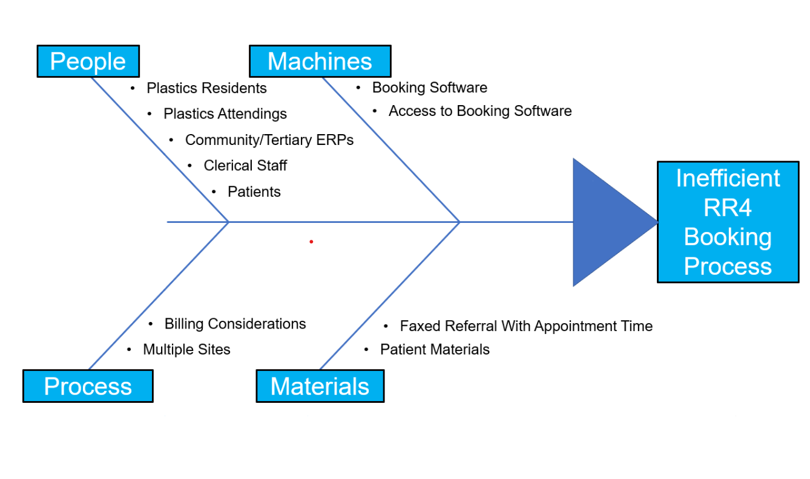
RFHS / Max Rady College of Medicine
Improving Flow in the Emergency Department by Giving ERPs Direct Access to RR4 Booking Software for Plastic Surgery Consults
ERP
Plastic Surgery Resident
- Time delay, work on ERP and resident end
Appointment
Patient presents
Streamline
Appointment
Christian Palaschuk PGY-2 Emergency Medicine
Summary of Problem
Patients who present to the emergency department requiring non-emergent plastic surgery consultation are often given a date and time to see plastic surgery in RR4 clinic
Obtaining an appointment is currently bottle-necked at the level of the plastic surgery residents (Figure 1)
Measurement
Will track length of stay (LOS) for RR4 referral appointment before ERP access to software booking
Once ERPs have access then LOS will be tracked and compared to that before access to assess improvement
Summary of Problem
Patients who present to the emergency department requiring non-emergent plastic surgery consultation are often given a date and time to see plastic surgery in RR4 clinic
Obtaining an appointment is currently bottle-necked at the level of the plastic surgery residents (Figure 1)
Figure 1: Process Map on Current vs Proposed RR4 Referral Process
Rationale
As the trauma centre in Manitoba many patients come to HSC with injuries requiring plastic surgery
Some patients are seen immediately in the ED, but some can be sent to the plastic surgery RR4 clinic
Although RR4 is very helpful in minimizing burden to the ED, making a referral to the clinic requires the plastic surgery team to book the appointment
Plastic surgery residents are often busy with patients or in the OR and can not be reached in a timely fashion
Certain referrals are clear indications for RR4 clinic
ERP access to the RR4 booking software would expedite patient’s receiving appointment times as well as unburden the plastic surgery residents from having to do this themselves
Time to patient disposition would be anticipated to improve.
Barriers
Involvement of all stakeholders
Disagreement with management plans
Software cost for increase users
inappropriate RR4 consultations by ERP
ERP re-education for appropriate of RR4 consults
Benefits
Benefit to plastic surgery team
Less disturbances/interruptions
Less night time disturbance
Scheduling based on procedures
Efficient and timely disposition for patients
Overall may benefit ED > plastic surgery
Benefits
Benefit to plastic surgery team
Less disturbances/interruptions
Less night time disturbance
Scheduling based on procedures
Efficient and timely disposition for patients
Overall may benefit ED > plastic surgery
Aim Statement
To provide ERP access to RR4 scheduling capabilities by Sept 1, 2024, to facilitate better flow and minimize patient time in ED
Figure 2: Ishikawa diagram describing potential causes for inefficient RR4 referral from the ED

