Slide 1

Waste Audit Education Session
RFP #FG080416

Slide 2
This presentation is being provided for educational purposes only
Please refer to the RFP for specific instructions
If there are any inconsistencies, the RFP and Amendments shall take precedence over this presentation
Notes:
2

Slide 3
Agenda
UofM Wants To Be Client of Choice
Current Environment
UofM Best Value RFP Process VS Traditional RFP Process
Timeline of RFP
Factors For Success

Slide 4
UofM Wants To Be Client of Choice
Open, Fair and Transparent
Better Business Environment
UofM Wants Suppliers to Send Their Best People On UofM Projects
Suppliers are allowed to be accountable, efficient, and creative (drive performance and maximize profit)
Reward performance through evaluations

Slide 5
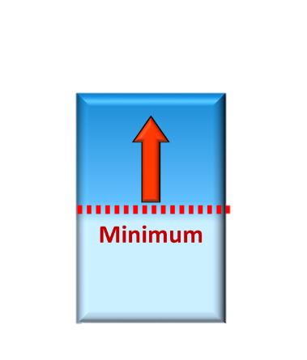
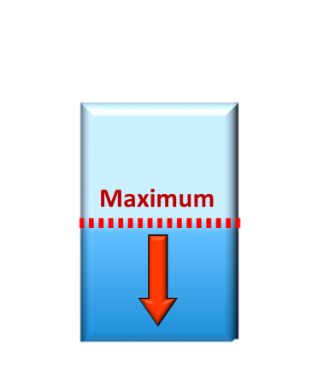
Perception of Standard
Owners
Suppliers
Notes:
KIMBERLEE
Before call travel agent, tend to look for flights yourself and then call the agent with what you want.
DISPLAY – TA form to FOP signing / travel agent / Travel Services / you.
Add phone and email slips

Slide 6
Who Will Be Selected
High
High
Supplier 1
Supplier 2
PERFORMANCE
PERFORMANCE
Supplier 3
Supplier 1
Supplier 3
Supplier 2
Supplier 4
Supplier 4
Low
Low
Notes:
KIMBERLEE
Before call travel agent, tend to look for flights yourself and then call the agent with what you want.
DISPLAY – TA form to FOP signing / travel agent / Travel Services / you.
Add phone and email slips

Slide 7
What Percent of RFP’s
Are 100% Accurate?

Slide 8

What is Best Value RFP
Win-Win
Client:
  Outsource to experts
  Higher performance
  Less management and resources
Supplier
  Control of project/service
  Ability to increase profit by maximizing their efficiency
RFP Turn Around Time
  RFP Closes Identify a Preferred Supplier in a week
  Clarification Phase- Pre-Plan Project Before Award

Slide 9
Factors For Success- Client Of Choice
Fair and Open (state/follow rules/open to all with experience)
Impartial and Transparent (minimize evaluator bias / provide debriefing)
Efficient (minimize efforts)
Award Based on Value

Slide 10

Our Goal Is To Obtain the Least Amount of Paper with the Most Important Information.
Notes:
Is the wording John Savicky’s? We don’t want the “Least” amount of Information, we want the “Least amount of Paper” or documentation, with the “Most” important information – this slide needs revision.
JT- Revised; Not from John’s Recent Slide. One of Kristin’s Slides

Slide 11
Written Approach
Goal is to keep process efficient
Minimize marketing material or general information
Only focus on the specific project
Only look at Risks, Value Added Ideas, Project Team, Project Plan

Slide 12
Best Value RFP
RFP
Best Value RFP does not mean:
  Eliminate the specification
  Eliminate the standards
  Eliminate the requirements
Suppliers must now understand that these are the clients best attempt at identifying what they need.
The RFP will still contain:
  Goals, expectations, desired outcomes, requirements
  Current conditions
Notes:
I have some concerns with this wording “Vendors must now understand that these are the clients best attempt at identifying what they need. The vendors must review and identify what the client really needs” Is this John Savicky’s wording? He must speak to it differently than it looks in writing. It sounds like the vendors need to figure out our needs. This slide needs revision.
We should say “supplier” in all slides, not “vendor”. Vendors sell hotdogs and coke.

Slide 13

What Would You Purchase

Slide 14

Which Would You Purchase??

Slide 15

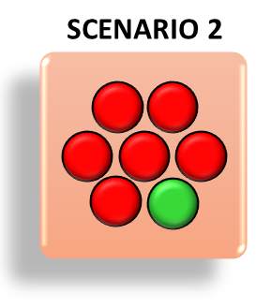
What is Dominant Information

Slide 16

Best Value RFP Process/System
High Level Overview
Details
SELECTION
CLARIFICATION
Proposal ($)
Schedule
Past Performance
Risk Assessment
Value Assessment
Project Plan
(Interview if required)
Clarification
Pre-Planning

Slide 17
Criteria and Weights
No | Waste Audit RFP Criteria | Weights
1 | Cost | 300
2 | Team Qualifications. (Interview May Be Required) | 300
3 | Risk Assessment Plan | 200
4 | Value Assessment Plan | 100
5 | Past Performance Information – Firm and Key Account Manager | 50
6 | Project Plan Summary (Interview May Be Required) | 50
 | Total Points | 1,000 Points
17
Notes:
JB: Not the Firm + KAM?
PD: Jurgens, what does your comment mean? Never mind, I see it on slide 24 Key Account Manager – slides need to be consistent

Slide 18

Proposal Package
(Attachments)
Attachment A – Proposal Cover Sheet
Attachment B – Proposal Form
Attachment C*- Team Qualifications
Attachment D* – Project Plan Summary
Attachment E – Project Plan Details
Attachment F* - Risk Assessments
Attachment G* – Value Assessment
Attachment H – Survey Questionnaires
Attachment I – Cost Proposal Form
The * Item Refers to Attachments Being Anonymous. No Supplier Names. No Names of People
18
Notes:
Attachment C s/b Project Plan not Plant
Do you speak to the * as being evaluated by the Evaluation Committee anonymously? You should.

Slide 19
Critical Formatting Requirements
The evaluated proposal documents MUST NOT contain any names that can be used to identify who the Proposer is.
Including: company names, personnel names, project names, or product names.
19

Slide 20
Risk Assessment Plan
Identify and prioritize all major risks (applicable to this project)
Risk =
  Not completing on time
  Not finished within budget
  Sources of dissatisfaction to the owner
Controllable vs Non-Controllable
  Controllable is covered in base proposal cost
  Non-Controllable is outside of base cost

Slide 21
Risk Assessment Controllable Risk
Supplier 1
  RISK: Noise from our demolition may result in student/staff complaints (since we will be doing demo in an in-operational library during finals week).
  SOLUTION: Partnering is a key to success on any project. We will work with the user to develop the best strategies that can be implemented to minimize the impact of noise from demolition.
Supplier 2
  RISK: Noise from our demolition may result in student/staff complaints (since we will be doing demo in an in-operational library during finals week).
  SOLUTION: To minimize this risk, we have planned to demolition during off hours and weekends. We will also install rubber sheets on the floors and foam pads around the wall to diminish noise and vibration

Slide 22
Risk Assessment Non-Controllable Risk
Supplier 1
  RISK: The local water company must have the water turned on by June in order for us to water the newly installed recreational fields (or the grass will die).
  SOLUTION: We will coordinate and plan our schedule with the water company as soon as the award is made to make sure that we get water to the site to irrigate the fields.
Supplier 2
  RISK: The local water company must have the water turned on by June in order for us to water the newly installed fields (or the grass will die). On past projects, the water company has failed to meet the schedule 90% of the time.
  SOLUTION: To minimize this risk, we will coordinate our schedule with the water company as soon as we are awarded the project. If they fail to meet our schedule, we can connect temporary waterlines to the nearby fire hydrants, or we can also rent water trucks to irrigate the fields.

Slide 23
Value Assessment
Opportunity to identify any value added options or ideas that may benefit the Owner and Agency.
This may include ideas or suggestions on alternatives in implementation strategies, timelines, project scope, equipment, goals, financing, etc.
All value added ideas must be logical and/or based on verifiable performance metrics.
Value added ideas is a separated from the main cost proposal. Prior to award, the Owner will determine if the value added items will be accepted or rejected
Notes:
Value added ideas are separated from the main cost proposal, not Value added ideas is a separated from the main cost proposal.

Slide 24

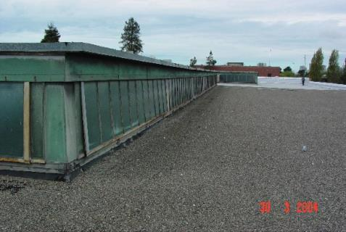
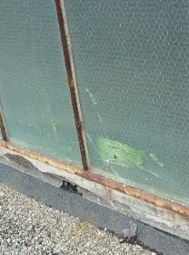
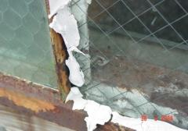
Example Value Assessment
Reroofing this building will not stop all water leaks. The majority of the leaks are caused by cracks in the walls, broken/missing glass, and poor caulking. We can repair/replace all of these issues to minimize all water leaks, for a minimal impact to time/funding.

Slide 25
Critical Formatting Requirements
Proposal is limited to
  1 Page = Team Qualifications
  1 Page = Assessment of Controllable Risks
  1 Page = Assessment of Uncontrollable Risks
  1 Page = Assessment of Value Added Ideas
  1 Page = Project Plan Summary

Slide 26
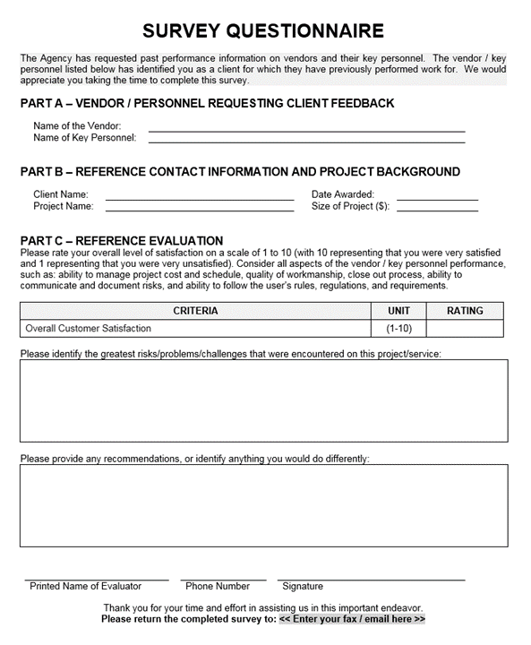
Past Performance Information
PPI will be collected on the following Entities:
  The Firm
  Key Account Manager
Procedures
  Prepare a list of past clients/projects
  Send out the Survey Questionnaires
  Collect and receive completed surveys
  Submit the best surveys with proposal
Notes:
JB: Compare my note to slide 14 i.e. Firm + KAM

Slide 27
Cost Proposal
Will Be Hidden From the Evaluation Committee
Suppliers will be short listed on Non- Cost Criteria. Only short listed Suppliers Costs will be Reviewed.
This Will Further Eliminate Evaluator Bias

Slide 28

How The Submittal
Process Works
Average
Score
Non-Evaluated
Documents
Proposal Form
(1 page)
Purchasing
Officer
Contracting
Officer
Evaluated
Documents
Proposal Form
(1 page)
Submittal
Evaluation Members
Notes:
JB: Format word breaks for readability.
PD: Looks like the arrows got distorted. Please fix.
Used ASU’s Actual Slide

Slide 29
Evaluated and Non Evaluated
Evaluated (Evaluation Committee)
  Team Qualifications
  Project Plan Approach and Summary
  Risk Assessments
  Value Assessments
  Non Evaluated (UofM Purchasing Services)
  Survey Responses
  Cost is Kept By Purchasing and Seperated From Rest of Proposal
Notes:
KIMBERLEE
Budget Officers need to advise their unit experts who they are. We’ve received a list of approx 275 people on campus who will be unit experts.

Slide 30
Evaluation Committee
3-5 individuals
Will be used to evaluate specific portions of the Proposal
Evaluators will not be provided with the names of any Proposers, product names, cost, or any additional information
Evaluators will independently (not as a group or consensus) review and score the items comparatively to one another
Objective of the scoring is to not make a decision (looking for “dominant” differential)
Evaluations will be scored on a 1/5/10 scale
  “10” = Dominantly higher value than the average (clearly shows differential)
  “5” = About average (insufficient information to make a clear decision)
  “1” = Dominantly below the average (clearly shows differential)
30

Slide 31


What Are We Looking For?
1
5
10
Looking For Dominant Differences in Team Qualifications, Risk Assessment, Value Adds, and Project Plans.

Slide 32
Score Before Cost in Each Criteria
NO | Criteria | Points | Firm A | Firm B | Firm C | Best | Firm A Points | Firm B Points | Firm C Points
1 | Cost | 300 | Not Released | Not Release | Not Released | Not Released | Not Released | Not Released | Not Released
2 | Team Qualifications | 300 | 4.5 | 8.1 | 8.1 | 8.1 | 167 | 300 | 300
3 | Risk Assessment Plant | 200 | 5.1 | 8.7 | 7.5 | 8.7 | 117 | 200 | 172
5 | Value Assessment Plant | 100 | 5.0 | 5.0 | 5.0 | 5 | 100 | 100 | 100
6 | PPI- References | 50 | 10 | 10 | 10 | 10 | 50 | 50 | 50
7 | Project Plan Approach and Summary | 50 | 10 | 5 | 5 | 10 | 50 | 25 | 25
Total |  | 1000
Total Before Cost |  | 700 |  |  |  |  | 484 | 675 | 647
% Before Cost |  |  |  |  |  |  | 69% | 96% | 92%
Notes:
JB: Add Example to the Title and check with Paul if he is comfortable with this slide. At least explain to the audience that this is partly taken from an actual case for illustration purposes only.
PD: We have a sample evaluation matrix at
http://umanitoba.ca/admin/financial_services/media/best_value_score.pdf
Use that please, instead
Inserted from UofM Website- However, different Criteria than Fire Alarm

Slide 33
Do We Interview???
Will an interview be value add?? Complexity of Project???
If we decide to do an interview, scores will be adjusted
Team Qualifications (300 Points) and Project Plan (50 Points)
33
Notes:
33
JB: Lead? Key Account Manager (for consistency)
PD: We allowed a phone interview in the IAM project, so you should say “No substitutes, proxies, phone, or electronic interviews are not normally will be allowed.
33

Slide 34
Key Personnel Interviews
The Client may interview the following individuals:
  Key Account Manager (overall contact / involved on the project every day)
All individuals must be available on the dates specified in the RFP. If a team member is not present for the interview, they will receive a 1 rating.
No substitutes, proxies, phone, or electronic interviews will be allowed.
Goals:
  Meet the critical personnel that are being assigned to the project
  Identify if personnel have experience and have thought about this project
  Identify if the personnel can think ahead and minimize potential risks
34
Notes:
34
JB: Lead? Key Account Manager (for consistency)
PD: We allowed a phone interview in the IAM project, so you should say “No substitutes, proxies, phone, or electronic interviews are not normally will be allowed.
34

Slide 35
Interview Format
This is not a “presentation”.
No other individual from the Proposer’s organization may attend
The individuals cannot bring any notes or handouts.
Interview times will be approximately 15-20 minutes per individual
A standard set of questions will be asked to each individual. The client has the option to clarify any responses.
Questions will be non-technical
Evaluators will rate/score the interviews comparatively to one another on a 1-5-10 scale
35
Notes:
35
35

Slide 36
Score Before Cost in Each Criteria
NO | Criteria | Points | Firm A | Firm B | Firm C | Best | Firm A Points | Firm B Points | Firm C Points
1 | Cost | 300 | Not Released | Not Release | Not Released | Not Released | Not Released | Not Released | Not Released
2 | Team Qualifications | 300 | 4.5 | 8.1 | 8.1 | 8.1 | 167 | 300 | 300
3 | Risk Assessment Plant | 200 | 5.1 | 8.7 | 7.5 | 8.7 | 117 | 200 | 172
5 | Value Assessment Plant | 100 | 5.0 | 5.0 | 5.0 | 5 | 100 | 100 | 100
6 | PPI- References | 50 | 10 | 10 | 10 | 10 | 50 | 50 | 50
7 | Project Plan Approach and Summary | 50 | 10 | 5 | 5 | 10 | 50 | 25 | 25
Total |  | 1000
Total Before Cost |  | 700 |  |  |  |  | 484 | 675 | 647
% Before Cost |  |  |  |  |  |  | 69% | 96% | 92%
Notes:
JB: Add Example to the Title and check with Paul if he is comfortable with this slide. At least explain to the audience that this is partly taken from an actual case for illustration purposes only.
PD: We have a sample evaluation matrix at
http://umanitoba.ca/admin/financial_services/media/best_value_score.pdf
Use that please, instead
Inserted from UofM Website- However, different Criteria than Fire Alarm

Slide 37
Final Scores with Cost
NO | Criteria | Points | Firm B | Firm C | Best | Firm B Points | Firm C Points
1 | Cost | 300 | $208,000 | $205,000 | $205,000 | 296 | 300
2 | Team Qualifications | 300 | 8.1 | 8.1 | 8.1 | 300 | 300
3 | Risk Assessment Plant | 200 | 8.7 | 7.5 | 8.7 | 200 | 172
5 | Value Assessment Plant | 100 | 5.0 | 5.0 | 5 | 100 | 100
6 | PPI- References | 50 | 10 | 10 | 10 | 50 | 50
7 | Project Plan Approach and Summary | 50 | 5 | 5 | 10 | 25 | 25
Total |  | 1000 |  |  |  | 971 | 947
% Before Cost |  |  |  |  |  | 97.1% | 94.7%
Notes:
JB: Add Example to the Title and check with Paul if he is comfortable with this slide. At least explain to the audience that this is partly taken from an actual case for illustration purposes only.
PD: We have a sample evaluation matrix at
http://umanitoba.ca/admin/financial_services/media/best_value_score.pdf
Use that please, instead
Inserted from UofM Website- However, different Criteria than Fire Alarm

Slide 38
Cost Reasonableness
If the # 1 scoring supplier is 5% higher in cost than the #2 supplier than UofM has the right to proceed with the #2 scoring supplier
38
Notes:
38
n
38

Slide 39
Final Scores with Cost
NO | Criteria | Points | Firm B | Firm C | Best | Firm B Points | Firm C Points
1 | Cost | 300 | $208,000 | $205,000 | $205,000 | 296 | 300
2 | Team Qualifications | 300 | 8.1 | 8.1 | 8.1 | 300 | 300
3 | Risk Assessment Plant | 200 | 8.7 | 7.5 | 8.7 | 200 | 172
5 | Value Assessment Plant | 100 | 5.0 | 5.0 | 5 | 100 | 100
6 | PPI- References | 50 | 10 | 10 | 10 | 50 | 50
7 | Project Plan Approach and Summary | 50 | 5 | 5 | 10 | 25 | 25
Total |  | 1000 |  |  |  | 971 | 947
% Before Cost |  |  |  |  |  | 97.1% | 94.7%
Notes:
JB: Add Example to the Title and check with Paul if he is comfortable with this slide. At least explain to the audience that this is partly taken from an actual case for illustration purposes only.
PD: We have a sample evaluation matrix at
http://umanitoba.ca/admin/financial_services/media/best_value_score.pdf
Use that please, instead
Inserted from UofM Website- However, different Criteria than Fire Alarm

Slide 40
Phase 2 - Clarification
1
2
SELECTION
CLARIFICATIon

Slide 41
What is the Clarification Period?
(Proactive vs Reactive)
Minimize All Surprises!!!

Slide 42
What Could Cause a Surprise
Delivering something that doesn’t work
Delivering something that isn’t what the client is expecting
Delivering something that isn’t what the client needed
Requiring the client to do something (that they did not know they had to do)
Requiring things from the client that they cannot provide
Expecting that something will happen as planned
Assuming that things are clear and understandable
Assuming that things will be done/occur as planned
Changes that impact cost
Changes that impact time
Poor satisfaction
42

Slide 43

How Can We Minimize Surprises
A Final Clarification Document is Created. Subject Mater Experts Required
Carefully preplan the project in detail
  Coordinate the project/service with all critical parties
  Prepare a detailed project plan (work plan, staffing, implementation, etc)
  Revisit the sites to do any additional investigating
  Prepare a detailed project schedule identifying critical milestones
Cost Verification
  Detailed cost breakdown
  Identify why the cost proposal may be significantly different from competitors
  Review big-ticket items
  Value added options
Identify all assumptions
  Prepare a list of all proposal assumptions
43

Slide 44
Obtain Internal UofM Approvals
Once Final Clarification Document is Completed and Recommended by Evaluation Committee , Internal UofM Approvals are Obtained.
Make the Formal Award
Execute Contract Documents
  Independent Contract Agreement (ICA)
44
Notes:
PD: You say “Once Final Clarification Document is Completed and Approved Internal UofM Approvals are Obtained.” Do you mean once “recommended” by the Evaluation Committee it is sent for approval? This sentence needs revision.
JT Fixed

Slide 45
UofM Wants To Be Client of Choice
Open, Fair and Transparent
Better Business Environment
UofM Wants Suppliers to Send Their Best People On UofM Projects
Suppliers are allowed to be accountable, efficient, and creative (drive performance and maximize profit)
Reward performance through evaluations

Slide 46
Timeline if No Interview
August 4- Issue RFP
August 11- Mandatory Pre-Proposal Conference/Question and Answer Session
August 25- RFP Closes (3 Weeks in Duration)
August 31- Prioritized Supplier is Identified
September 1 - Start Clarification Period

