Slide 1


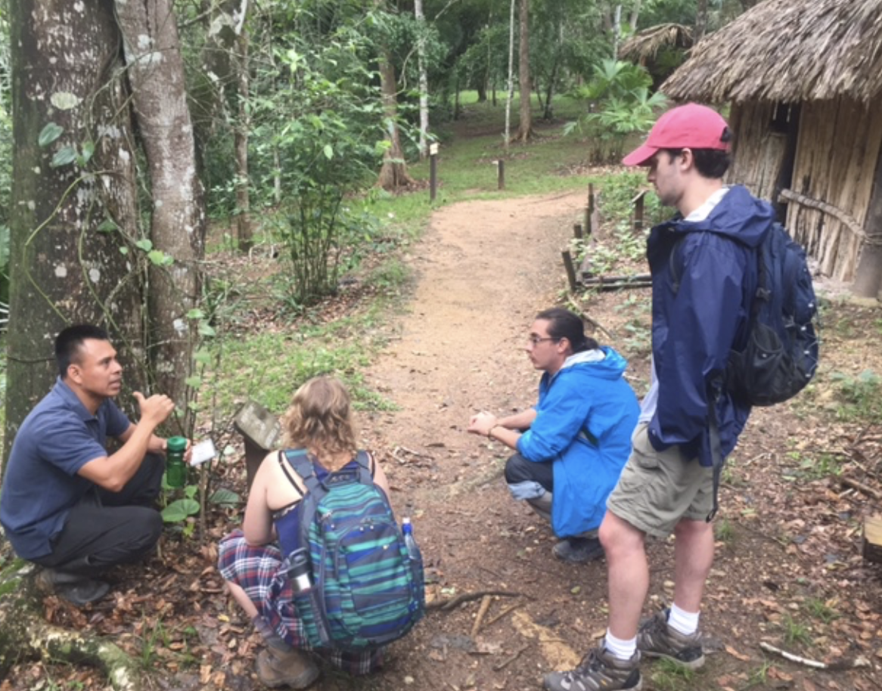
Queen Elizabeth II Diamond Jubilee Scholarship: Engaging Indigenous Languages, Knowledges, Learning and the Land
Information for prospective applicants provided by the Faculty of Education
Photo credits: CELA Belize

Slide 2
Overview
Introduction to the QESII team
Goal of the program
Target audience and funding
What the experience will involve
Key expectations
An interview with Dr. Nakagawa and Dr. Penados
Timelines
Q&A

Slide 3
The QESII Program Team
Dr. Sandie Kouritzin (Education)
Ms. Rosanna Caruso (Education)
Dr. Clea Schmidt (Education)
Dr. Satoru Nakagawa (Arts)
Dr. Filiberto Penados (Natural Resources Institute and CELA, Belize)

Slide 4
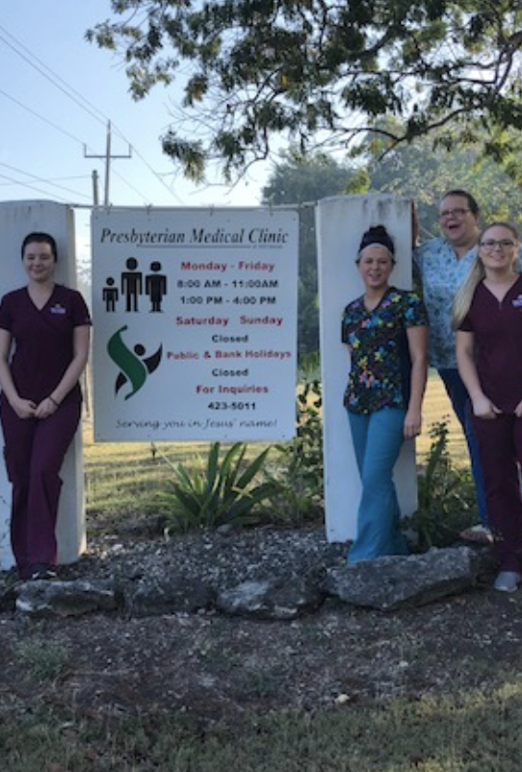
Goal of the Program
To create a community of education-focused scholars who will become leaders and advocates in global Indigenous language vitality, Indigenous ontologies and epistemologies, Indigenous food sovereignty and learning from the land. This scholarship program, available through 2024, focuses on both community-based and higher-education efforts.

Slide 5
Target audience and funding
Senior undergraduates (who have completed a min. of 30 credit hours) and graduate students in good academic standing who are passionate to learn about, complete an internship in, and contribute to a global Indigenous context.
The QES program will provide a total of $6,000 to each accepted to the program to cover the costs of travel and living expenses while in Belize. Your time in Belize will involve a minimum of 90 days plus orientation. Students should budget for additional expenses (e.g., spending money, travel around the country, etc.).

Slide 6
What the experience will involve
QES scholars will enrich their understanding of Indigenous education and community within Belize and share their learning with local communities and through an online QES course. QES scholars will participate in:
A mandatory full day pre-departure workshop
An orientation session hosted by CELA Belize upon arrival in the country.
A three-credit, online course completed by all students entitled, Endangered and Minority Languages and Cultures , completed while in Belize. More information about this course will be provided to students once accepted.
Local community engagement activities and workshops organized by CELA.
Opportunities to connect with other QES Scholars and alumni around the world.

Slide 7
Key expectations
You will require travel and health insurance and Criminal Record and Child Abuse Registry checks.
You will participate in the QES II Community of Scholars from the time of acceptance, throughout the internship period and following the internship. Involvement in the Community may include organizing or participating in events, volunteering, sharing research results o r methodologies, supporting fellow QES II Scholars, or mentoring new Scholars as they enter the program. There is the expectation of sharing your QES experience via social media.

Slide 8
An interview with Dr. Nakagawa and Dr. Penados
https://umanitoba-my.sharepoint.com/personal/satoru_nakagawa_umanitoba_ca/Documents/Attachments/Dr.%20Filiberto%20Penados%20interview.mp4
In this interview, Dr. Penados shares examples of the types of internships that can be provided through CELA Belize, as well as information about Belize itself.

Slide 9
Timelines
Travel to Belize | Applications available | Information Session | Applications due | Pre-departure Orientation Session
May-Aug 23 | Now | Sept 13/22, 12:00 noon-1:30 pm Faculty of Education Room 228 | Oct 17/22 | March 15/23, 5:00-7:00 pm Faculty of Education Room 228
Sept-Dec 23 | Now | Nov 9/22, 12:00 noon-1:30 pm Faculty of Education Room 228 | Feb 13/23 | June 7/23, 5:00-7:30 pm Faculty of Education Room 228
Jan-April 24 | TBA | TBA | TBA | TBA
May-Aug 24 | TBA | TBA | TBA | TBA
We continue to monitor covid-19 developments. We will continue to accept applications however applicants must be aware that their exchanges could be cancelled or postponed if travel restrictions are re-imposed.

Slide 10
For more information and to register
Program info and application package
https://umanitoba.ca/education/student-experience/qe2-scholarship
CELA Belize
https://celabelize.com
QES
https://www.youtube.com/watch?v=_o62lHxnghc

