Slide 1
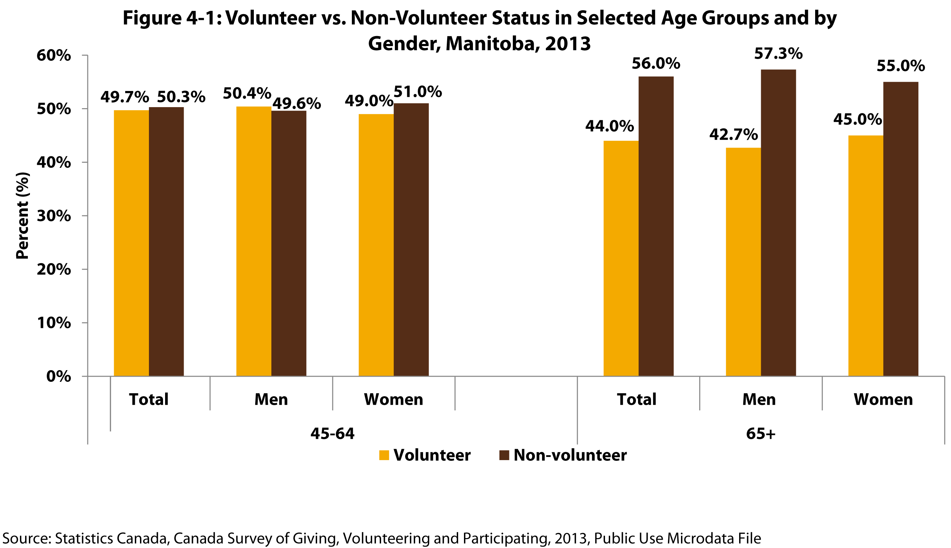
Notes:
How to cite this graphic:
Figure 4-1: Volunteer vs. Non-Volunteer Status in Selected Age Groups and by Gender, Manitoba, 2013. Reprinted from Facts on Aging: Volunteering and charitable giving, by the Centre on Aging, retrieved from http://www.umanitoba.ca/aging
Copyright 2017 by the Centre on Aging, University of Manitoba.

