Slide 1
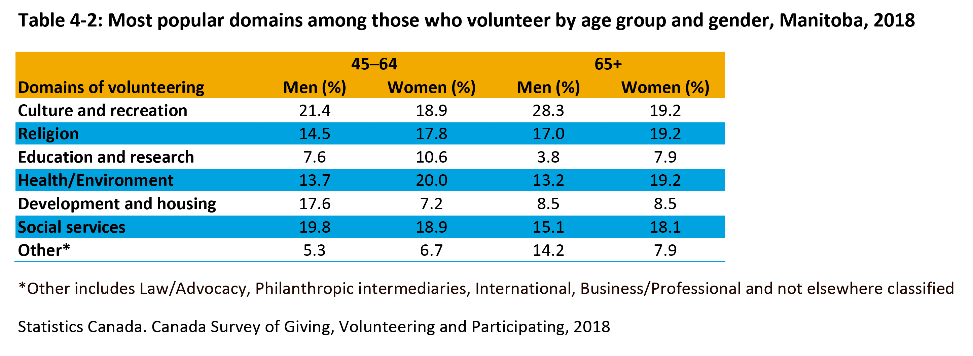

©2022 Centre on Aging, University of Manitoba
Notes:
How to cite this graphic:
Table 4-2: Most popular domains among those who volunteer by age group and gender, Manitoba, 2018. Reprinted from Facts on Aging: Volunteering and charitable giving, by the Centre on Aging, retrieved from http://www.umanitoba.ca/aging
Copyright 2021 by the Centre on Aging, University of Manitoba.

