Slide 1
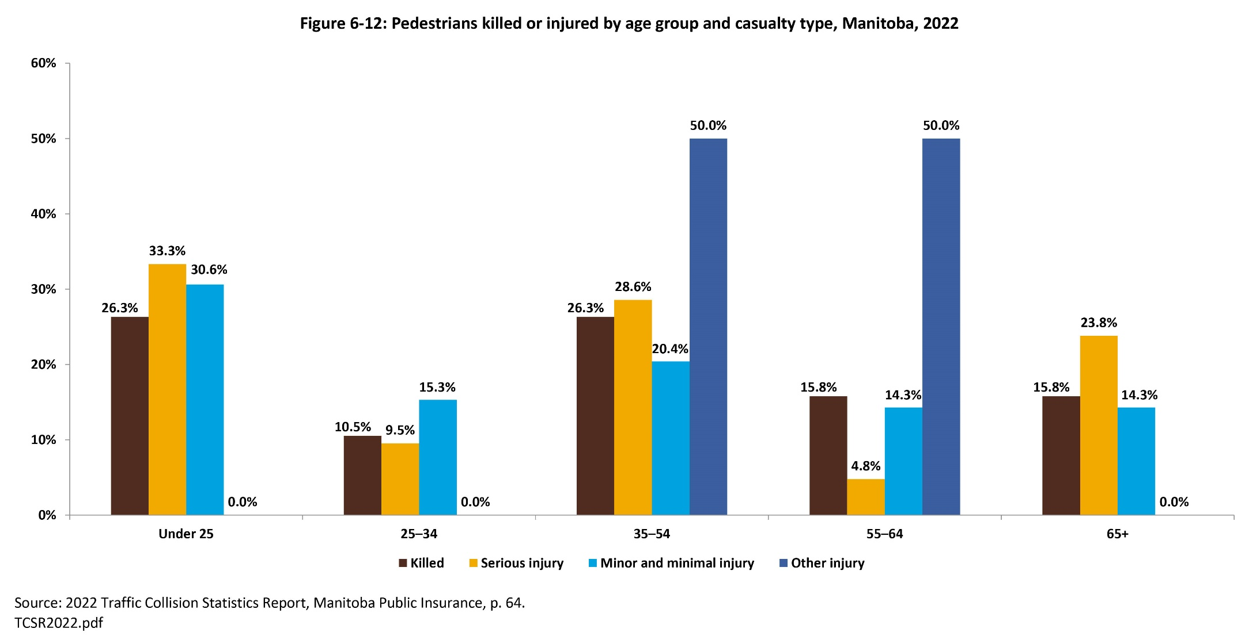

©2025 Centre on Aging, University of Manitoba
Notes:
How to cite this graphic:
Figure 6-12: Pedestrians killed or injured by age group and casualty type, Manitoba, 2022. Reprinted from Facts on Aging: Transportation, by the Centre on Aging, retrieved from http://www.umanitoba.ca/aging
Copyright 2025 by the Centre on Aging, University of Manitoba.

