Slide 1
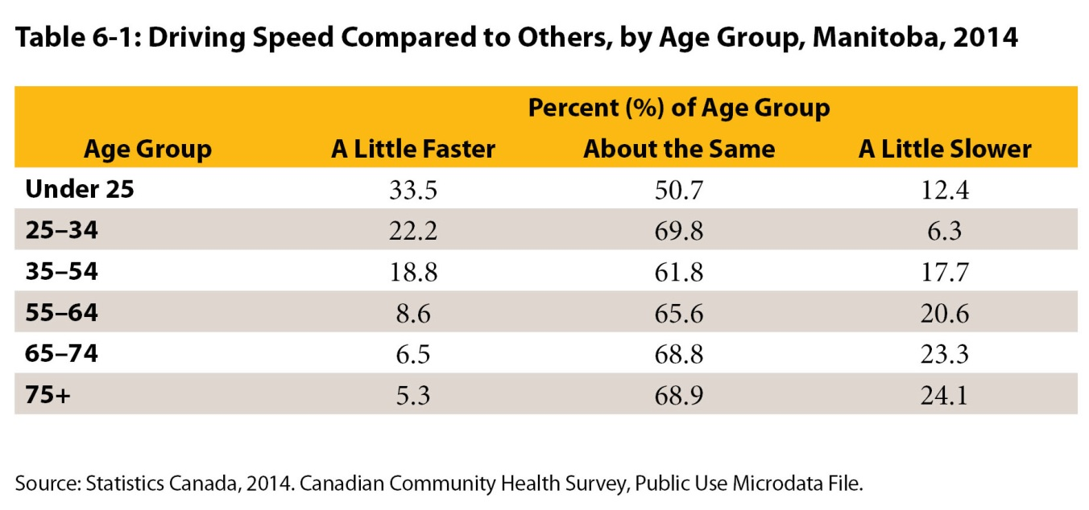

©2017 Centre on Aging, University of Manitoba
Notes:
How to cite this graphic:
Table 6-1: Driving Speed Compared to Others, by Age Group, Manitoba, 2014. Reprinted from Facts on Aging: Transportation, by the Centre on Aging, retrieved from http://www.umanitoba.ca/aging
Copyright 2017 by the Centre on Aging, University of Manitoba.

