Slide 1
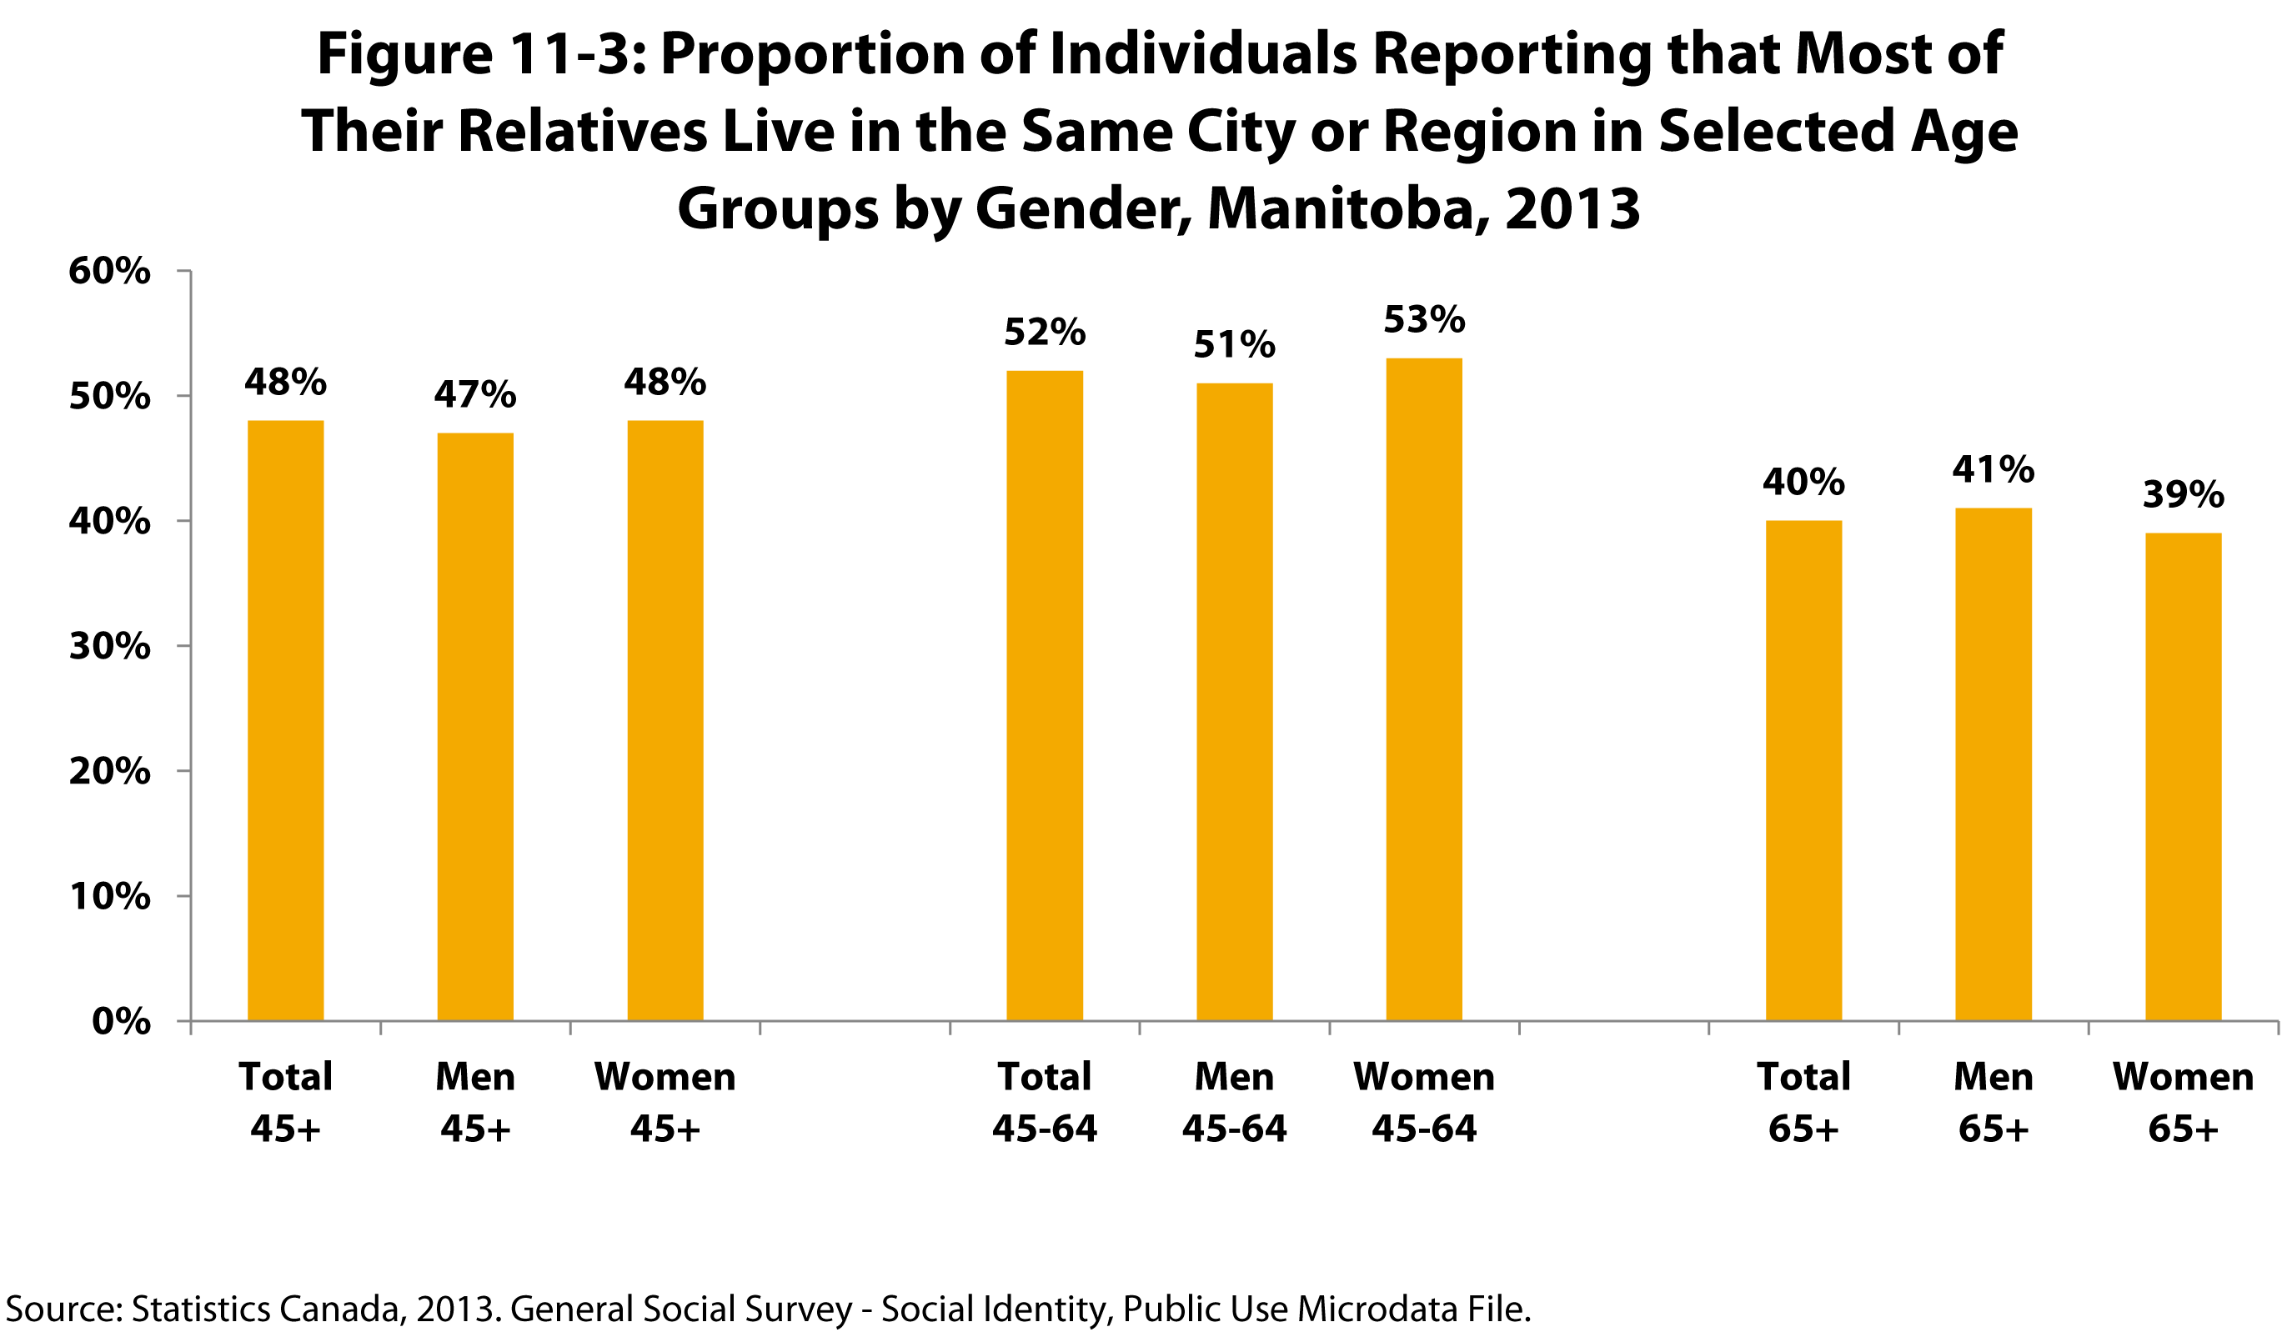

©2017 Centre on Aging, University of Manitoba
Notes:
How to cite this graphic:
Figure 11-3: Proportion of Individuals Reporting that Most of Their Relatives Live in the Same City or Region in Selected Age Groups by Gender, Manitoba, 2013. Reprinted from Facts on Aging: Social Connections by the Centre on Aging, retrieved from http://www.umanitoba.ca/aging
Copyright 2017 by the Centre on Aging, University of Manitoba.

