Slide 1
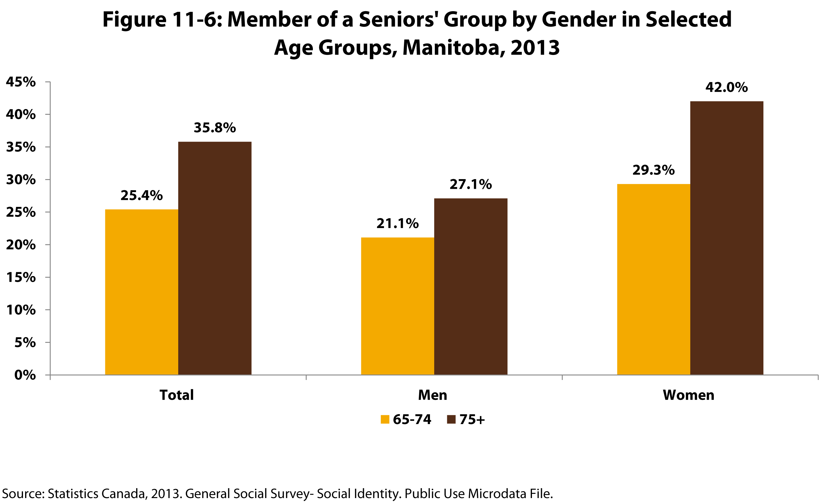

©2017 Centre on Aging, University of Manitoba
Notes:
How to cite this graphic:
Figure 11-6: Member of a Seniors' Group by Gender in Selected Age Groups, Manitoba, 2013. Reprinted from Facts on Aging: Social Connections by the Centre on Aging, retrieved from http://www.umanitoba.ca/aging
Copyright 2017 by the Centre on Aging, University of Manitoba.

