Slide 1
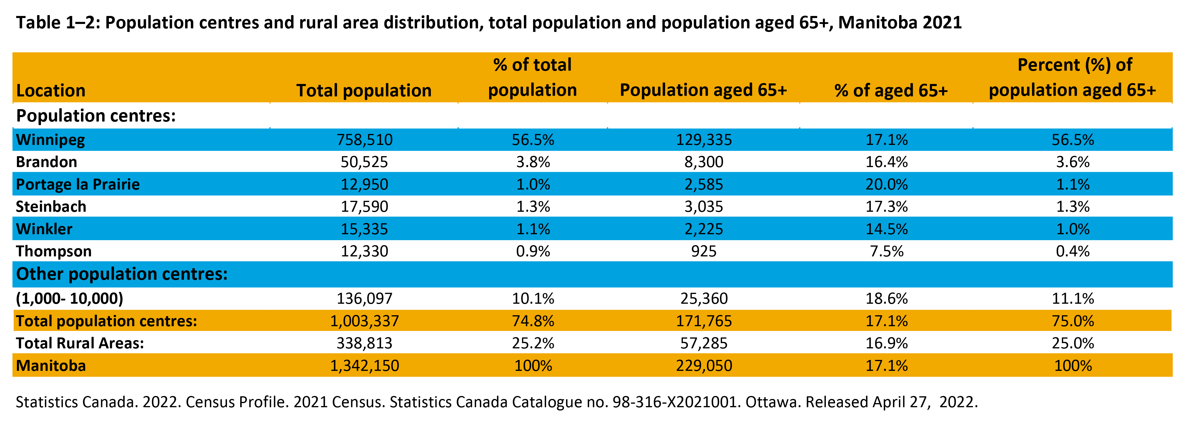
©2022 Centre on Aging, University of Manitoba
Notes:
How to cite this graphic:
Table 1-2. Population Centres and Rural Area Distribution, Total Population and Population Aged 65+, Manitoba, 2021. Reprinted from Facts on Aging: Demographics, by the Centre on Aging, retrieved from http://www.umanitoba.ca/aging
Copyright 2022 by the Centre on Aging, University of Manitoba.

