Slide 1
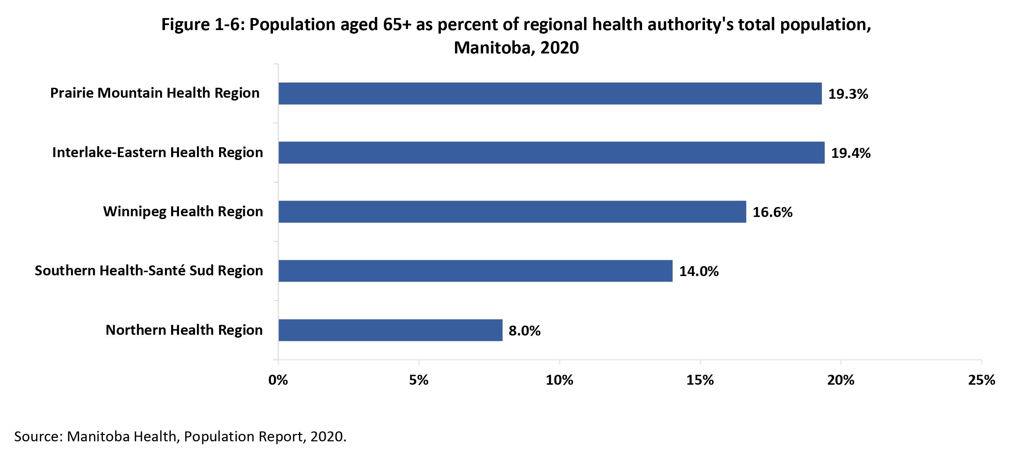

©2022 Centre on Aging, University of Manitoba
Notes:
How to cite this graphic:
Figure 1-6: Population aged 65+ as percent of regional health authority's (RHA’s) total population, Manitoba, 2020. Reprinted from Facts on Aging: The older worker, by the Centre on Aging, retrieved from http://www.umanitoba.ca/aging
Copyright 2022 by the Centre on Aging, University of Manitoba.

