Slide 1
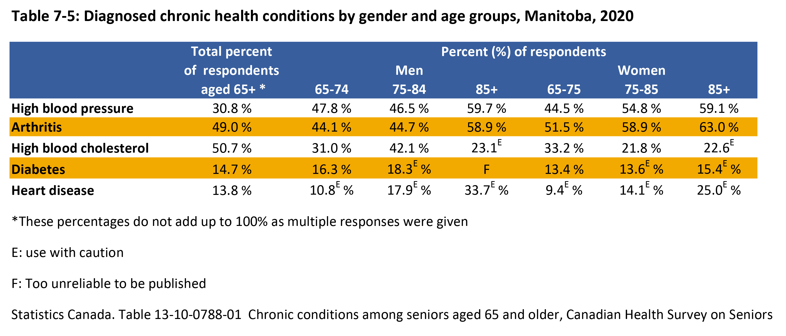

©2022 Centre on Aging, University of Manitoba
Notes:
How to cite this graphic:
Table 7-5: Diagnosed chronic health conditions by gender and age groups, Manitoba, 2020. Reprinted from Facts on Aging: Physical health status, by the Centre on Aging, retrieved from http://www.umanitoba.ca/aging
Copyright 2022 by the Centre on Aging, University of Manitoba.

