Slide 1
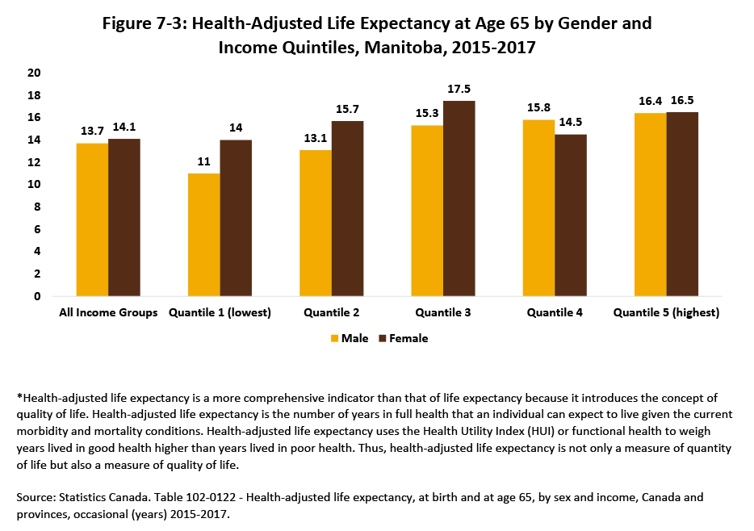

©2020 Centre on Aging, University of Manitoba
Notes:
How to cite this graphic:
Figure 7-3: Health-Adjusted Life Expectancy at Age 65 by Gender and Income Quintiles, Manitoba, 2015–2017. Reprinted from Facts on Aging: Physical Health Status, by the Centre on Aging, retrieved from http://www.umanitoba.ca/aging
Copyright 2020 by the Centre on Aging, University of Manitoba.

