Slide 1
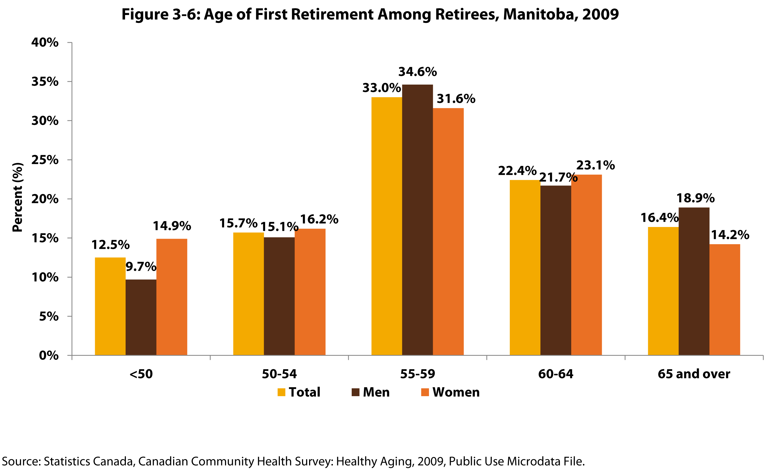
Notes:
How to cite this graphic:
Figure 3-6: Age of First Retirement Among Retirees, Manitoba, 2009. Reprinted from Facts on Aging: The older worker, by the Centre on Aging, retrieved from http://www.umanitoba.ca/aging
Copyright 2017 by the Centre on Aging, University of Manitoba.

