Slide 1
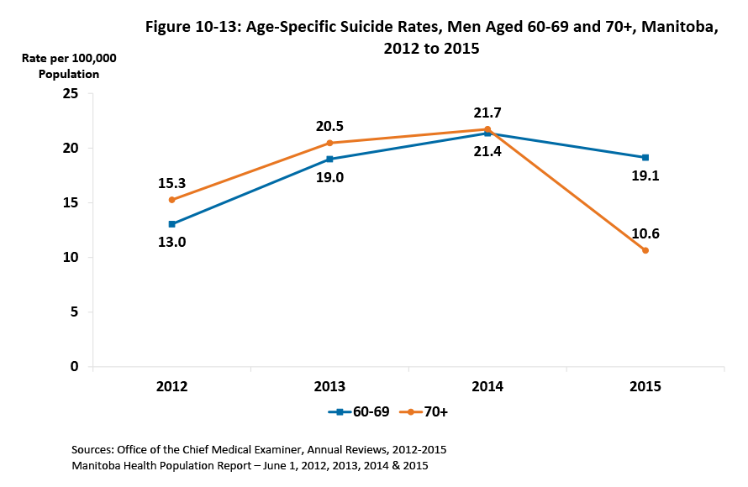

©2018 Centre on Aging, University of Manitoba
Notes:
How to cite this graphic:
Figure 10-13: Age-Specific Suicide Rates, Men Aged 60-69 and 70+, Manitoba, 2012 to 2015. Reprinted from Facts on Aging: Mental health status, by the Centre on Aging, retrieved from http://www.umanitoba.ca/aging
Copyright 2018 by the Centre on Aging, University of Manitoba.

