Slide 1
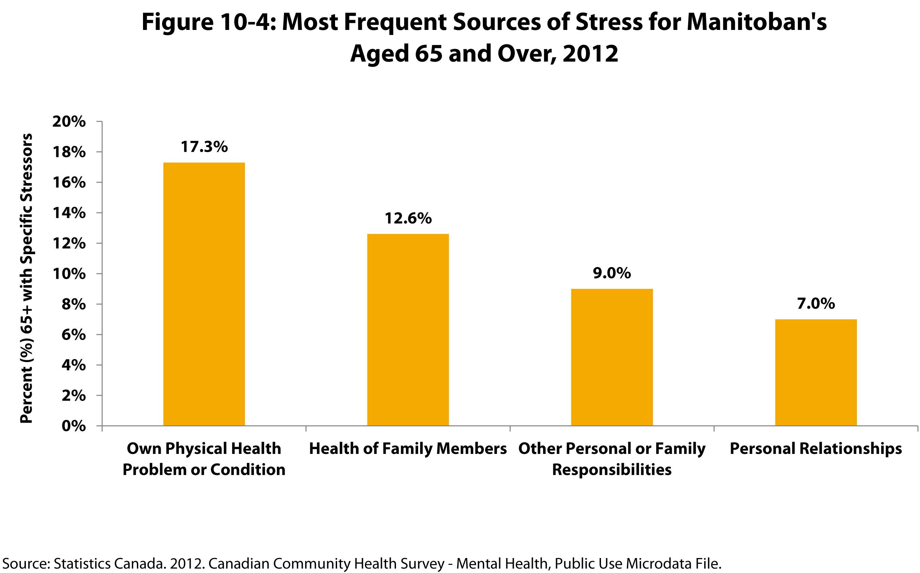

©2017 Centre on Aging, University of Manitoba
Notes:
How to cite this graphic:
Figure 10-4: Most Frequent Sources of Stress for Manitoban's Aged 65 and Over, 2012. Reprinted from Facts on Aging: Mental Health Status by the Centre on Aging, retrieved from http://www.umanitoba.ca/aging
Copyright 2017 by the Centre on Aging, University of Manitoba.

