Slide 1
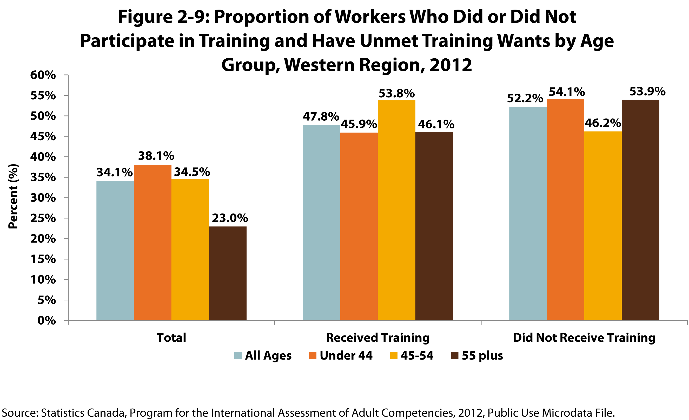
Notes:
How to cite this graphic:
Figure 2-9: Proportion of Workers with Unmet Training Wants by Age Group, Western Region, 2012. Reprinted from Facts on Aging: Lifelong learning, by the Centre on Aging, retrieved from http://www.umanitoba.ca/aging
Copyright 2017 by the Centre on Aging, University of Manitoba.

