Slide 1
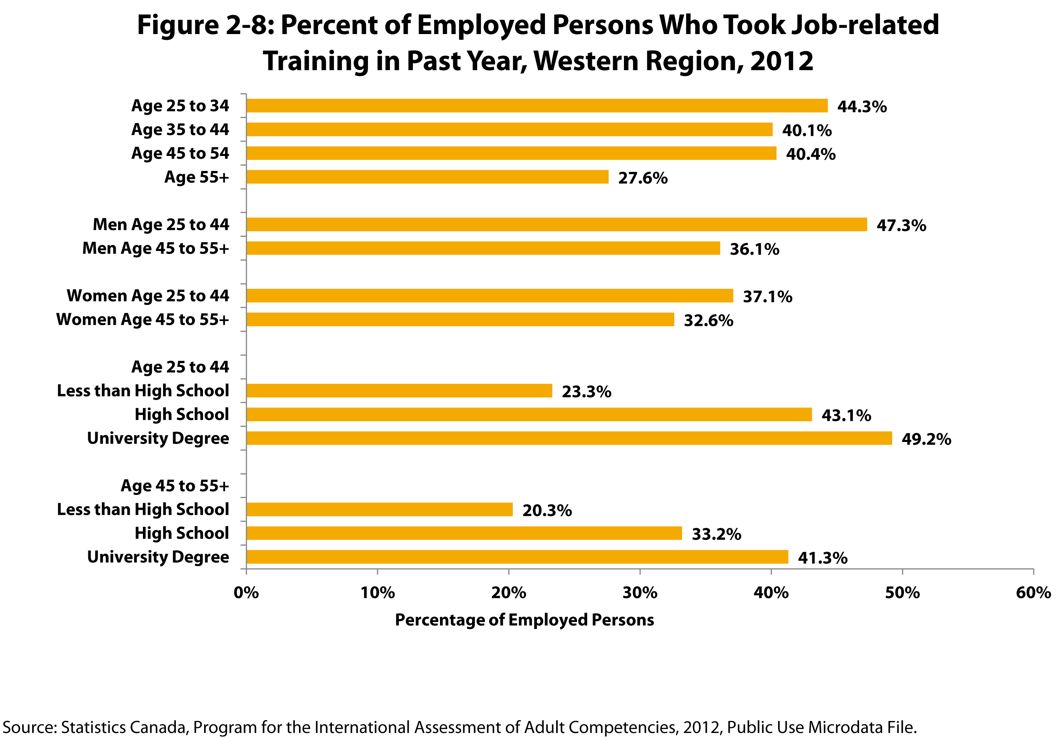
Notes:
How to cite this graphic:
Figure 2-8: Percent of Employed Persons Who Took Job-related Training in Past Year, Western Region, 2012. Reprinted from Facts on Aging: Lifelong learning, by the Centre on Aging, retrieved from http://www.umanitoba.ca/aging.
Copyright 2017 by the Centre on Aging, University of Manitoba.

