Slide 1
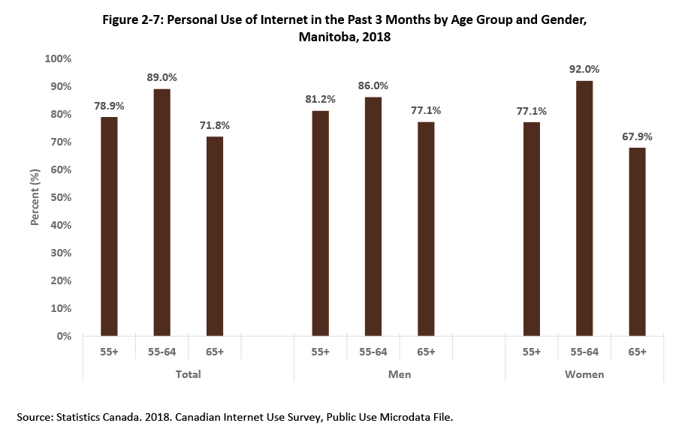
©2018 Centre on Aging, University of Manitoba
Notes:
How to cite this graphic:
Figure 2-7: Personal Use of Internet in the Past 12 Months by Age Group and Gender, Manitoba, 2013. Reprinted from Facts on Aging: Lifelong learning, by the Centre on Aging, retrieved from http://www.umanitoba.ca/aging
Copyright 2018 by the Centre on Aging, University of Manitoba.

