Slide 1
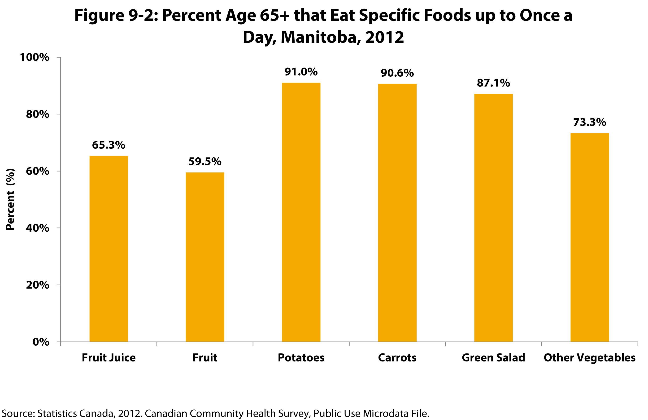

©2017 Centre on Aging, University of Manitoba
Notes:
How to cite this graphic:
Figure 9-2: Percent Age 65+ that Eat Specific Foods up to Once a Day, Manitoba, 2012. Reprinted from Facts on Aging: Healthy Eating by the Centre on Aging, retrieved from http://www.umanitoba.ca/aging
Copyright 2017 by the Centre on Aging, University of Manitoba.

