Slide 1
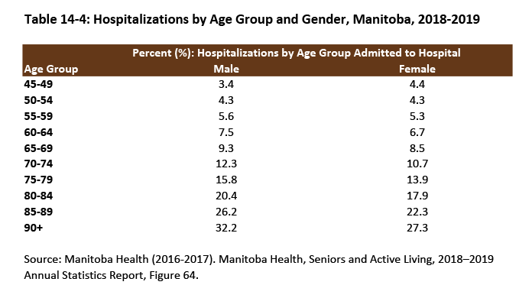

©2020 Centre on Aging, University of Manitoba
Notes:
How to cite this graphic:
Table 14-4: Hospitalizations by Age Group and Gender, Manitoba, 2018-2019. Reprinted from Facts on Aging: Health care and community services, by the Centre on Aging, retrieved from http://www.umanitoba.ca/aging
Copyright 2020 by the Centre on Aging, University of Manitoba.

