Slide 1
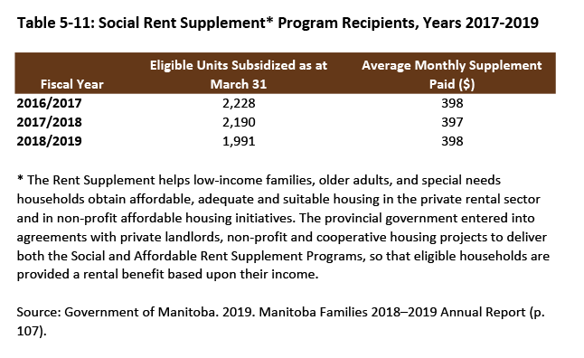

©2020 Centre on Aging, University of Manitoba
Notes:
How to cite this graphic:
Table 5-11: Social Rent Supplement* Program Recipients, Years 2017-2019. Reprinted from Facts on Aging: Financial well-being, by the Centre on Aging, retrieved from http://www.umanitoba.ca/aging
Copyright 2020 by the Centre on Aging, University of Manitoba.

