Slide 1
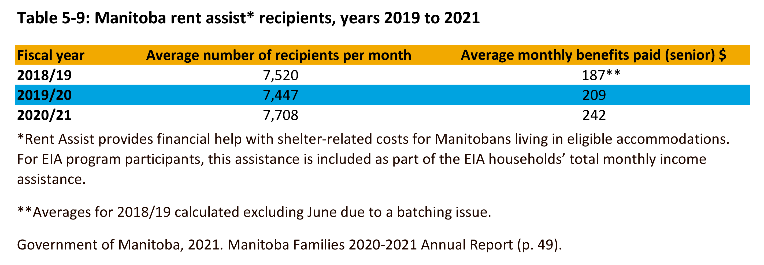

©2022 Centre on Aging, University of Manitoba
Notes:
How to cite this graphic:
Table 5-9 Manitoba rest assist* recipients, years 2019 to 2021. Reprinted from Facts on Aging: Financial well-being, by the Centre on Aging, retrieved from http://www.umanitoba.ca/aging
Copyright 2022 by the Centre on Aging, University of Manitoba.

