Slide 1
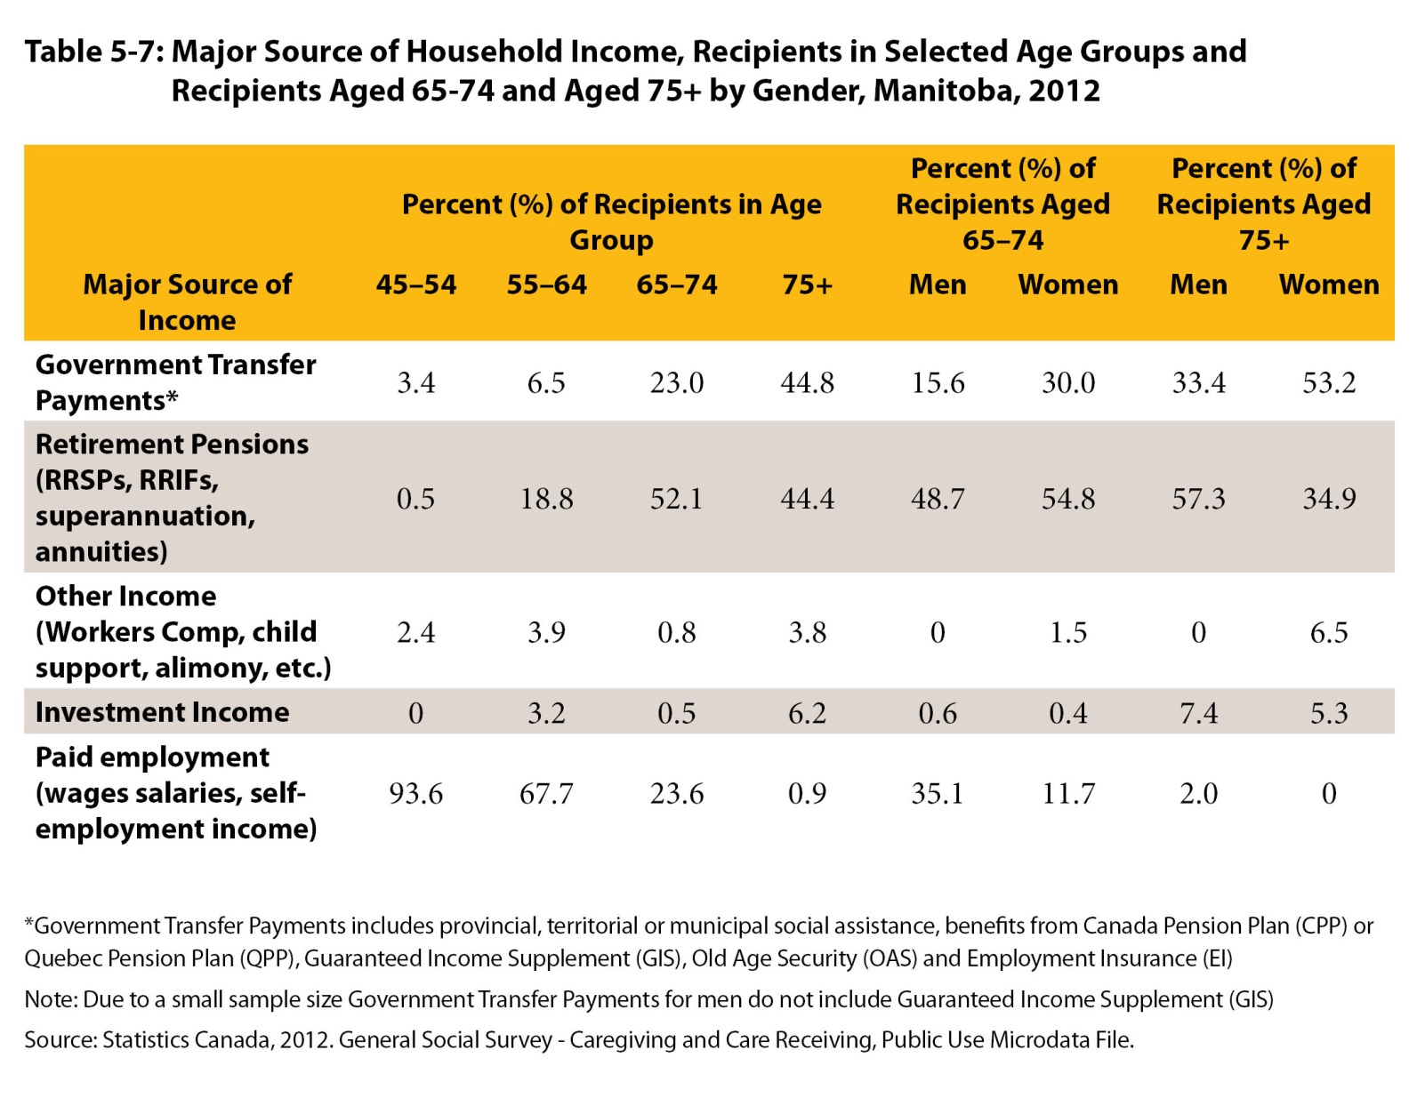

©2017 Centre on Aging, University of Manitoba
Notes:
How to cite this graphic:
Table 5-7: Major Source of Household Income, Recipients in Selected Age Groups and Recipients Aged 65-74 and Aged 75+ by Gender, Manitoba, 2012. Reprinted from Facts on Aging: Financial well-being, by the Centre on Aging, retrieved from http://www.umanitoba.ca/aging
Copyright 2017 by the Centre on Aging, University of Manitoba.

