Slide 1
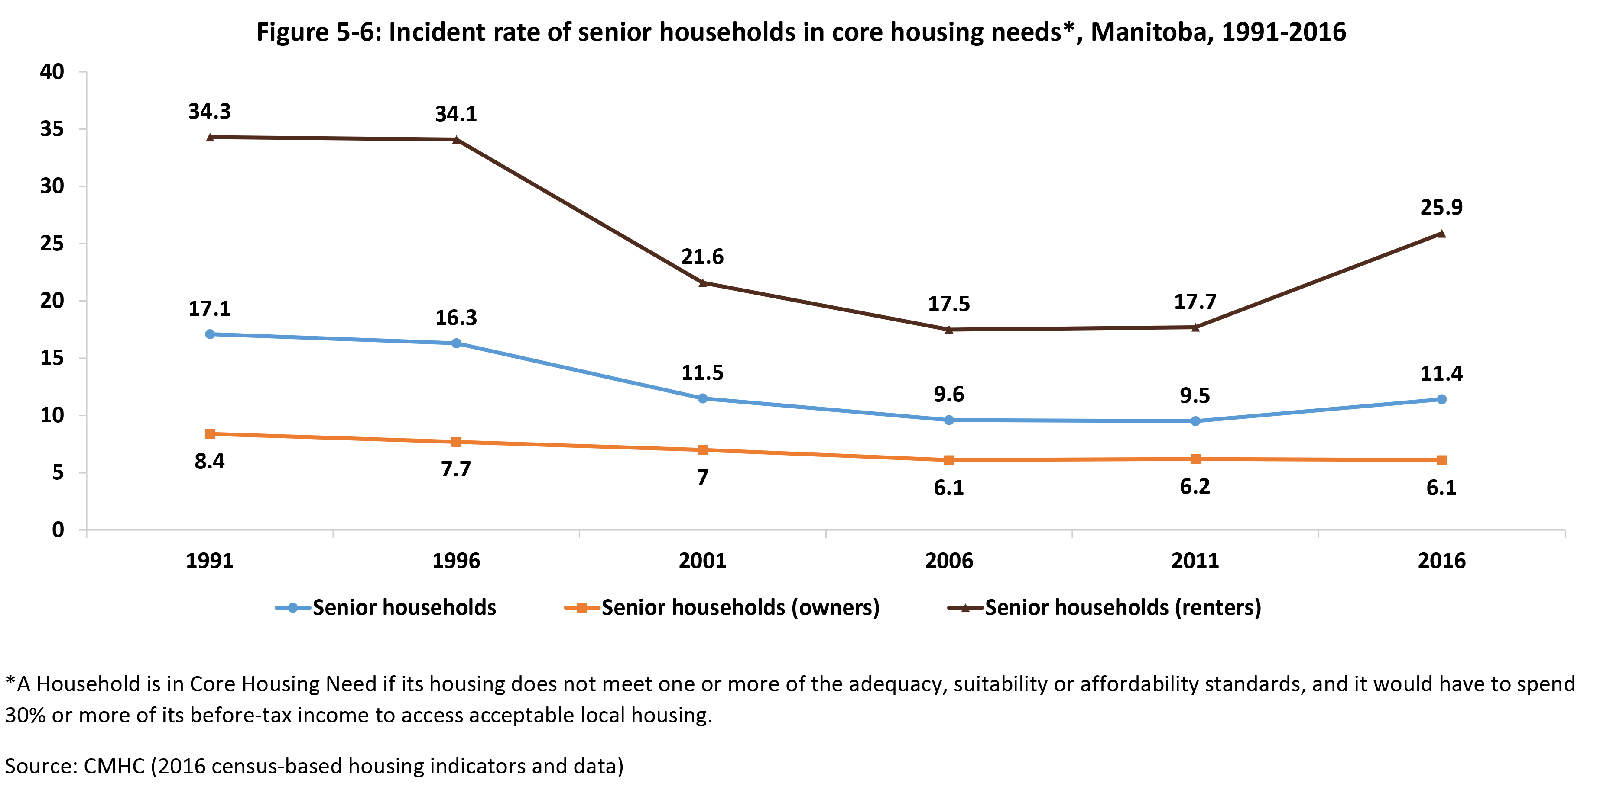

©2022 Centre on Aging, University of Manitoba
Notes:
How to cite this graphic:
Figure 5-6: Incident rate of senior households in core housing need, Manitoba, 1991–2016. Reprinted from Facts on Aging: Financial well-being, by the Centre on Aging, retrieved from http://www.umanitoba.ca/aging
Copyright 2022 by the Centre on Aging, University of Manitoba.

