Slide 1
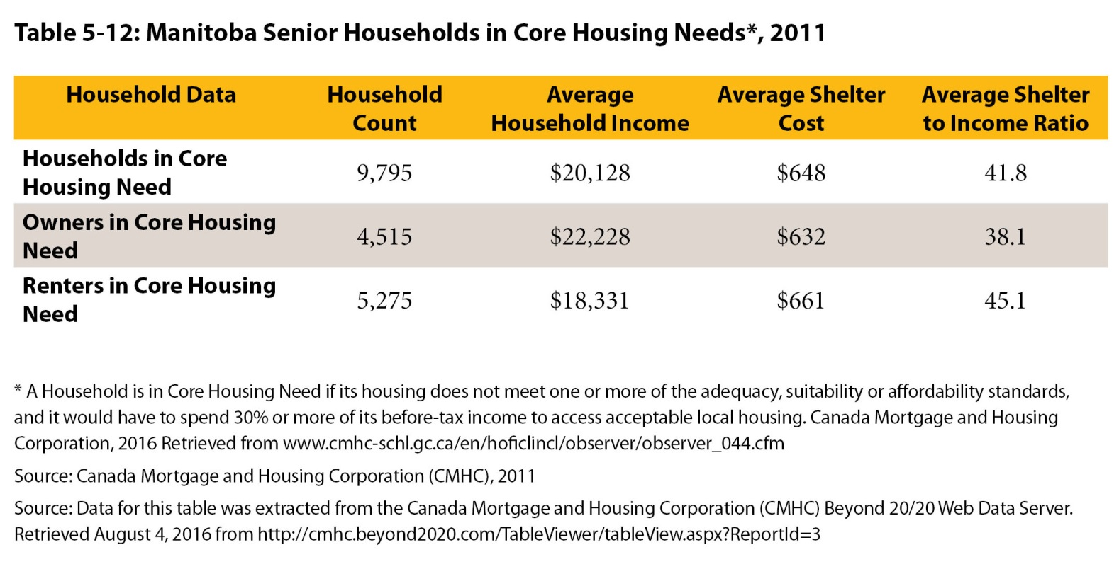
©2017 Centre on Aging, University of Manitoba
Notes:
How to cite this graphic:
Table 5-12: Manitoba Senior Households in Core Housing Needs, 2011. Reprinted from Facts on Aging: Financial well-being, by the Centre on Aging, retrieved from http://www.umanitoba.ca/aging
Copyright 2017 by the Centre on Aging, University of Manitoba.

