Slide 1
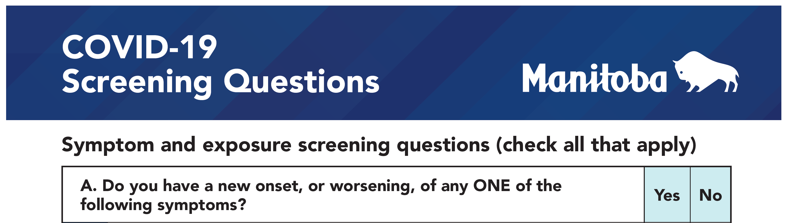
Important:
Self-monitor daily for COVID-19 symptoms and/or exposures before attending any on-campus activities

Slide 2
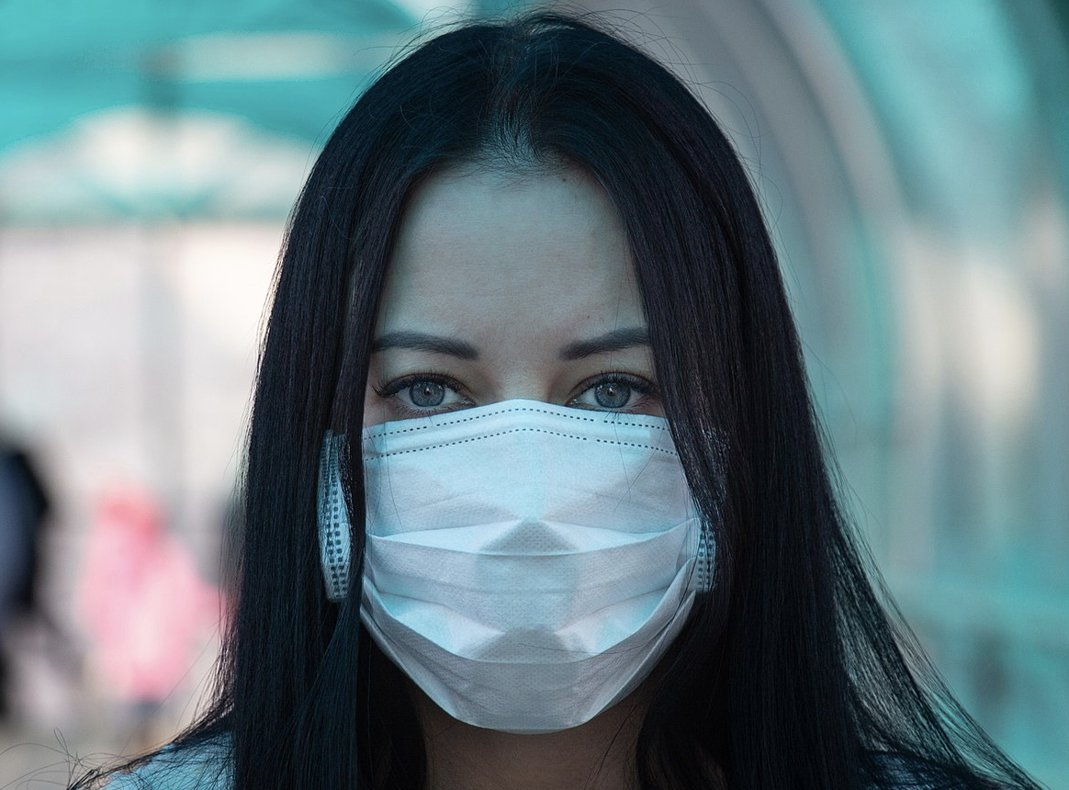
Important:
Masks (KN95 or Level 2 Medical) are mandatory on campus.
Do not eat in class. Brief, infrequent sips of a beverage are acceptable.
Class will begin when everyone is properly masked.

