Slide 1
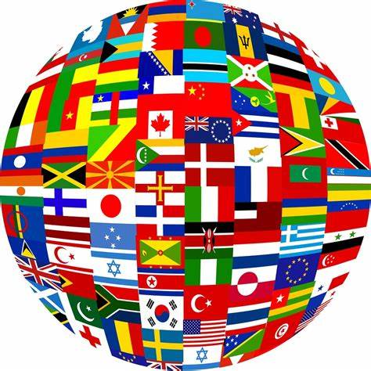
Why are Languages Important?
By: Hannah Ginter, Judith Hübert & Elliot Falk

Slide 2
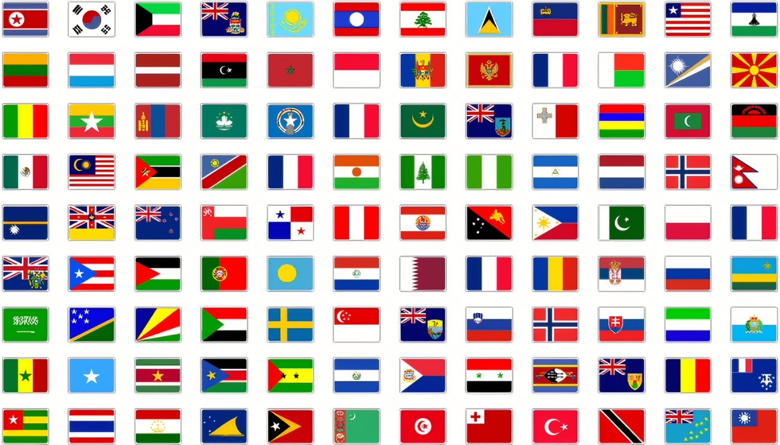
What are Languages?
Languages are a system of communication used by a nation or community. A system of traditional spoken, written, and manual (signed) symbols used by humans to express themselves as members of a certain group or culture.

Slide 3
What are the top 4 Benefits of Learning a Second Language?

Slide 4
Provide Opportunities for the Future
The ability to speak another language can be a significant competitive advantage on a resume that allows you to stand out from monolingual candidates.
By mastering a foreign language, it allows you to establish connections and professional partnerships that you might not otherwise be able to.
Several other programming languages, including Java, Python, and C++, have become highly in demand in recent years, giving you a number of opportunities.

Slide 5
Feed your Brain
Speaking multiple languages enhances memory, problem-solving skills, critical thinking skills, concentration, multitasking abilities, and listening skills.
Learning a second language can improve communication skills and multiply vocabulary in your first language.

Slide 6
See the World
Once you learn a new language you can travel to a place where that language is spoken.
You can communicate with others, and you won't need to worry about the struggle to understand what someone is saying.
Be it directions or just a simple conversation.
It makes the experience so much easier and more relaxed!

Slide 7
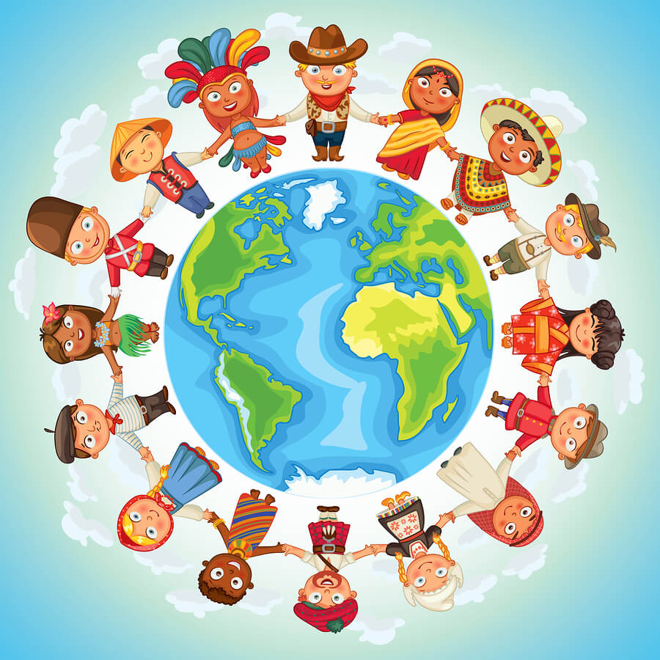
Develop a Deeper Understanding of Other Cultures
When one comprehends a new language, it comes the time to learn more about the culture. This way you can really connect with the people.
You can learn about their past, heritage and the traditions that they have. It's always interesting to learn about different ways that people live and gives you more of a broad perspective.
Languages can follow you through more than one country, for example; German is spoken in Germany, Switzerland and Austria!

Slide 8
What Are You Waiting For?

