Slide 1
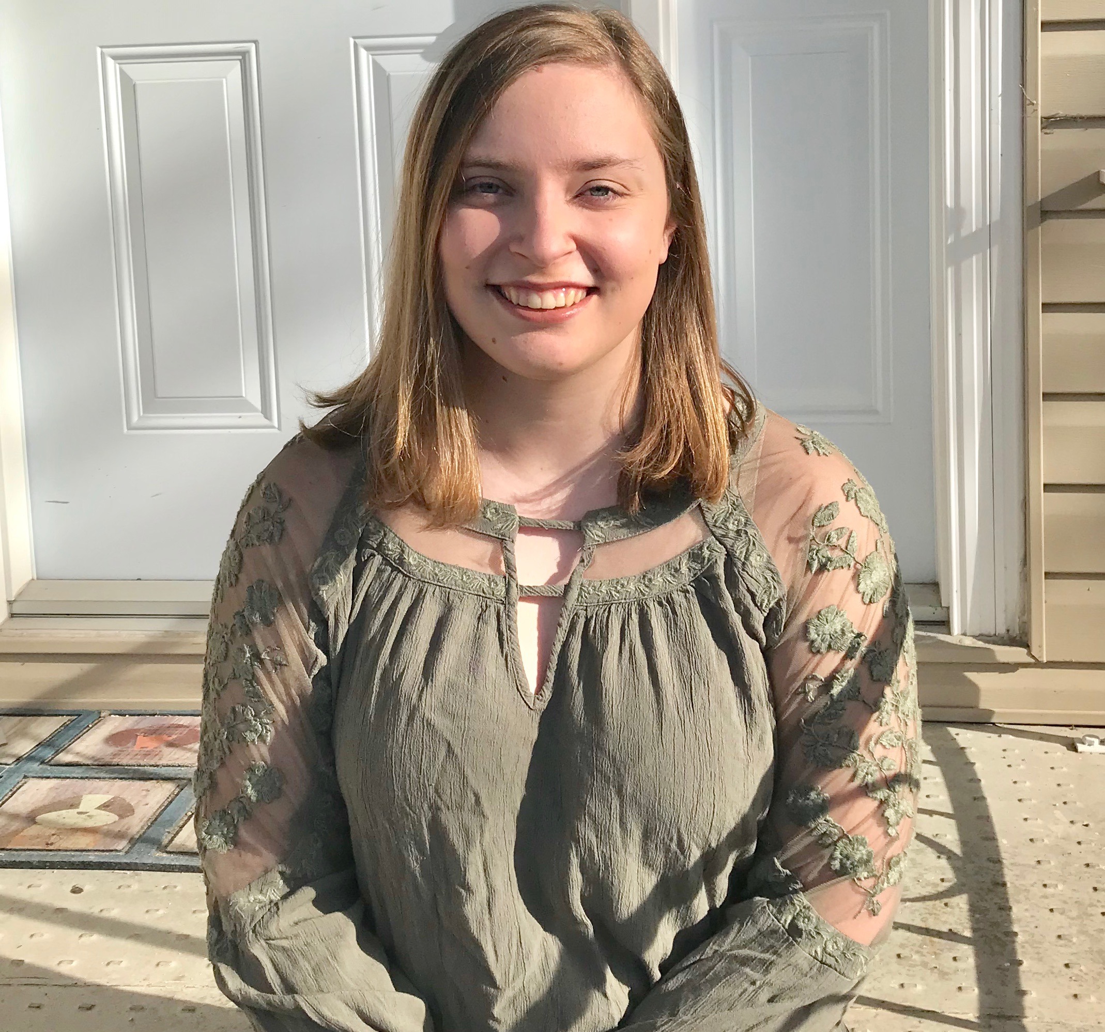
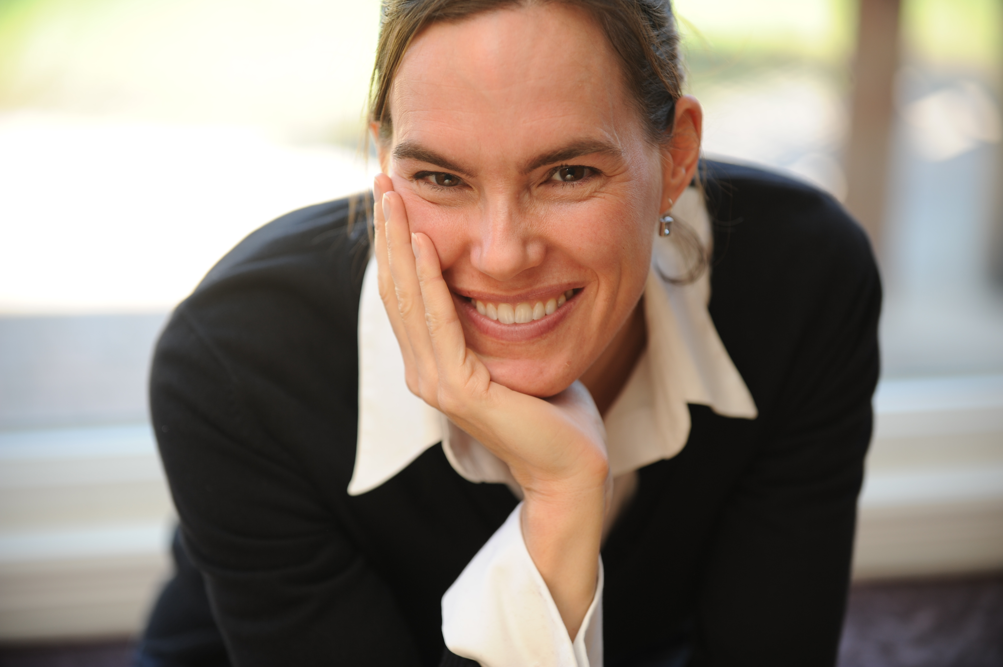
Ins and outs of the MA joseph-Armand Bombardier Canada Graduate Scholarships
Laura Conrad, MA Candidate and Andrea Charron, PhD
Dr. Andrea Charron
Associate Professor and Director of the Centre for Defence and Security Studies,
University of Manitoba
Laura Conrad, BAH and MA Candidate at the University of Calgary, Political Science and CGA winner

Slide 2
Agenda
Overview of the scholarship
Application requirements
Questions
Break out rooms with faculty

Slide 3
Tri-Council Agency Funding
The Government of Canada supports academic research through three different councils (Tri-Council)
NSERC (Natural Sciences and Engineering Research Council)
CIHR (Canadian Institutes of Health Research)
SSHRC (Social Sciences and Humanities Research Council)
950 Masters’ Awards
540 Masters’ Awards
1,510 Masters’ Awards

Slide 4
What is the Joseph-Armand Bombardier Scholarship?
This is the Masters scholarship awarded under the Social Sciences and Humanities Research Council
Winners receive $17,500, awarded over a twelve month period
It is non-renewable
The award may only be held at a Canadian institution (note this is a change from the past)

Slide 5
University Allotments
Each university has a certain allotment of scholarships to award (based on size of student body). Must be enrolled full-time.
Université St. Boniface – 2
See https://www.nserc-crsng.gc.ca/Students-Etudiants/CGSAllocations-QuotasBESC_eng.asp for other institution allotments
3
1
28
7

Slide 6
To be eligible to apply, you must:
Be a Canadian citizen or permanent resident of Canada
Be enrolled in, have applied for, or will apply for full-time admission to a Masters program at a Canadian institution
Have completed, as of December 31 of the year of the application, between zero and twelve months of full-time studies
Not have previously held a Canada Graduate Studies Masters Scholarship
High academic standing
Submit a maximum of one scholarship application per academic year to the Tri-Council agencies
Submit your application directly to SSHRC before December 1, 2020 at 8:00PM ET
https://www.nserc-crsng.gc.ca/Students-Etudiants/PG-CS/CGSM-BESCM_eng.asp#star

Slide 8
Application Requirements
CCV
Two References (preferably academic)
Transcripts – must be official
Outline of Proposed Research

Slide 9
Getting Started
Create an application and account using the Research Portal https://portal-portail.nserc-crsng.gc.ca/
Complete an application overview
You must make only one selection for field of research, even if your proposed research is inter- or multidisciplinary in nature and/or appears to span the mandates of more than one agency.
Submit a list of potential universities where you will complete your research (maximum of three)
Complete an activity details questionnaire (What are the themes of your research? Is there sex and gender-based analysis? Are you using human participants?)
Consider completing this online, free course at https://tcps2core.ca/welcome

Slide 10
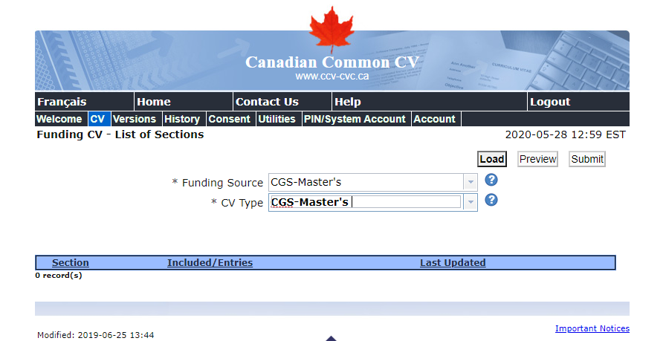
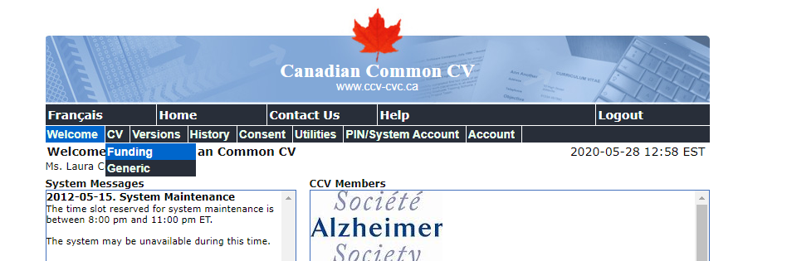
CV
Your CV must be submitted using Canadian Common formatting
Create an account at https://ccv-cvc.ca/loginresearcher-eng.frm
Go to the tab “CV” and click “funding”
3. In tab “funding source” click on “CGS Master’s”
4. Then you’ll basically just have to fill in a bunch of blanks

Slide 11
References
Every applicant must have two references
You will invite two individuals to submit references on your application and they will upload the reference once it is complete
ASK EARLY
But also make sure you have a research question and draft of your proposal completed as your reference will likely want to read it
If possible, try and find references who know you outside of just being a student in their class

Slide 12
Transcripts
You must upload up-to-date official transcripts of all undergraduate and graduate studies
Unofficial transcripts or web printouts will not be accepted and if used, will eliminate your application from the competition
Transcripts should be printed in the Fall term of their application.
Even if you are starting at a new institution in the Fall and have not received any grades yet, you must still include a transcript from that institution.

Slide 13
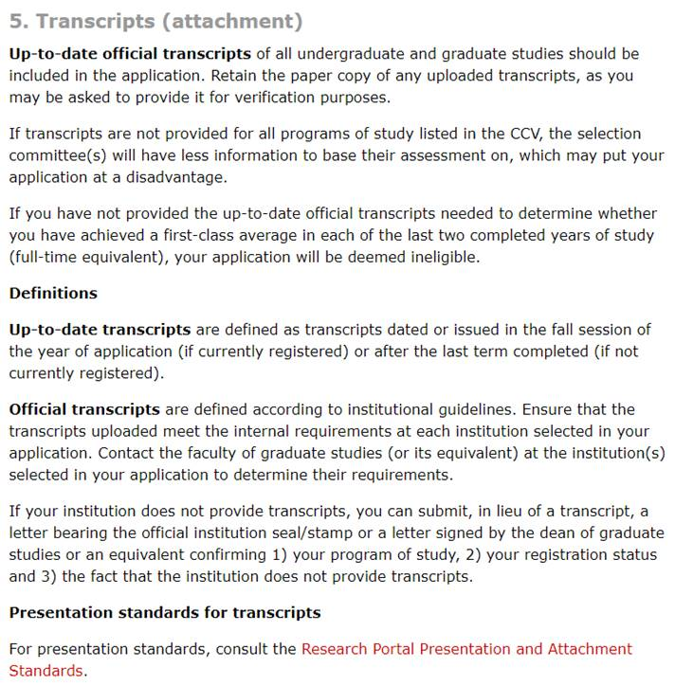
Attaching transcripts can be a bit tricky… that is why it is good to give yourself lots of time. You will need to include your FALL 2020 transcript

Slide 14
Research Proposal
Maximum of one page (plus one page of references)
This is a critical part of your application
Your topic/proposal may change as you continue your studies. So long as you are not changing disciplines, this is okay.
In your proposal you must:
State the objectives and hypothesis and outline the experimental or theoretical approach to be taken (citing literature is pertinent to the proposal)
State the methods and procedures to be used
State the significance of the proposed research to a field or fields in social sciences and/or humanities

Slide 15
Ask yourself these questions when writing your proposal…
So what? Why does this research matter?
Does this research advance the literature?
Does it have real world application?
Do I have a bona fide question?
What are my assumptions?
Have I defined my variables?

Slide 16
Tips for Writing a Research Proposal
Use plain, simple language
Use punchy, active voice
Read it out loud
Revise, revise, revise
Bounce ideas off of classmates, friends and family
Have a ready copy of the INSTRUCTIONS found at https://www.nserc-crsng.gc.ca/ResearchPortal-PortailDeRecherche/Instructions-Instructions/CGS_M-BESC_M_eng.asp

Slide 17
Supplemental Options
MINDS scholarship initiative supplements are one-time supplements valued at $10,000.
All applicants whose research is related to the MINDS policy challenges and/or Canada’s defence policy, Strong, Secure, Engaged, are eligible to apply for these supplements. To be considered for supplemental funding, you must
select the MINDS scholarship initiative supplements option from the drop-down menu
complete the Statement of thematic relevance (maximum 3,000 characters)
MINDS master’s scholarships for Indigenous students are one-year, non-renewable awards valued at $17,500. Applicants who self-identify as Indigenous and whose research is related to the MINDS policy challenges and/or Canada’s defence policy, Strong, Secure, Engaged, are eligible to apply for these scholarships.
If you win a CGS, you can receive extra $6,000 for research conducted outside of Canada called Michael Smith Foreign Study supplements

Slide 18
Check List for completed File
application form
outline of the proposed research, including bibliography and citations
all required undergraduate and graduate transcripts (originals)
CGS M CCV
two reference assessments

Slide 19
Final Words of Advice
Due 1 December 2020 before 8pm ET. No exceptions for any reasons.
Once submitted, your application cannot be changed.
Start the application process early.
It is fiddly but worth every moment.
Follow instructions to the letter - https://www.nserc-crsng.gc.ca/ResearchPortal-PortailDeRecherche/Instructions-Instructions/CGS_M-BESC_M_eng.asp
Keep in mind that the components of your application will be useful for your grad school applications.
Try and enjoy the process.

Slide 20
Questions?

Slide 21
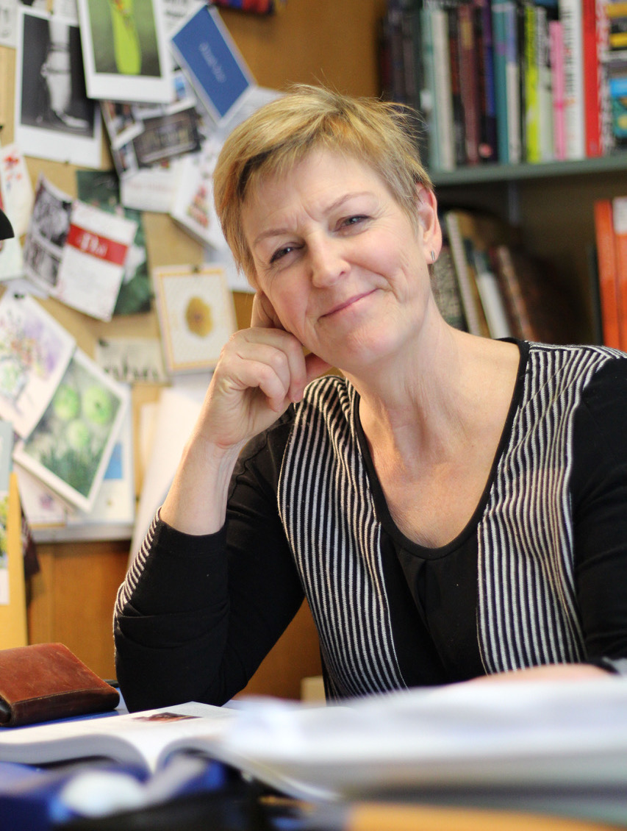
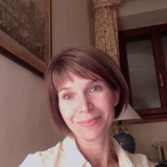
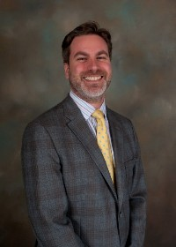
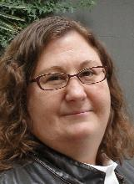
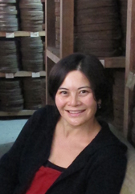
Dr. Susan Prentice is the Duff Roblin Professor of Government which has a current focus on care, gender, and social policy. This appointment builds on her current role as academic lead of the childcare policy stream of a seven-year SSHRC Partnership Grant, "What is the Best Policy Mix for Diverse Canadian Families with Young Children? Re-imagining Canadian Family Policies."
Dr. Roisin Cossar is Professor in Historyand completed a PhD at the University of Toronto. Her SSHRC-funded publications include two books and several articles and essays on the social history of the Christian church in Italy during the later Middle Ages. She currently holds a SSHRC Insight Grant for a multi-year project examining the relationship between seasonality and religious culture in late medieval Italy.
Dr. Mike Sampson is an Associate Professor in the Department of Classics at the University of Manitoba. He holds a PhD from the University of Michigan. His research interests include Greek tragedy, poetry and myth, Senecan tragedy, papyrology. Dr. Sampson holds a SSRHC Connection Grant.
Dr. Kiera L. Ladner is Canada Research Chair in Miyo we'citowin, Indigenous Governance and Digital Sovereignties, and Professor in the Department of Political Studies at the University of Manitoba. Her research focuses on Indigenous Politics and Governance; Digital Sovereignties and Archiving; gender; women and governance; and resurgence.
Dr. Tina Chen holds a PhD from the University of Wisconsin-Madison. She is currently the Department Head and Professor in the Department of History at the University of Manitoba. Her research interests include Modern China, film projection and film cultures in socialist and post-socialist China, and Chinese migration and documentary regimes.

